Slide 1
Global Radio basic Intro (Mixed-Mode)

Slide 2
Overview
HW/SW Architectural and layer

Slide 3
Overview
Arch/DB/History
Radio Architecture
Database view
Startup
Deployment view
TX/RX
Design WoW
Tx Module
Carrier Event Processing
SPLC
Rx Module
Debugging/QA
UT
QA

Slide 4
Radio Architecture

Slide 5
Radio – digital/analog line
RU (Radio Unit)
CPRI 2.5G, 5G, 9.8G, or 10.1G
Digital Section
Filter Unit
Linearization
Up Convert
PA
DL
DL
DAC
DL
DL
A
DU (Digital Unit)
DL
ADC
TOR (PA output)
DL
B
UL
UL
C
Down Convert
LNA
UL
ADC
UL
UL
D
Digital
Analog
ADC – Analog to Digital Converter DAC – Digital to Analog Converter LNA – Low Noise Amplifier PA – Power Amplifier

Slide 6
Radio – analog

Slide 7
Legacy view (warp 3x)

Slide 8
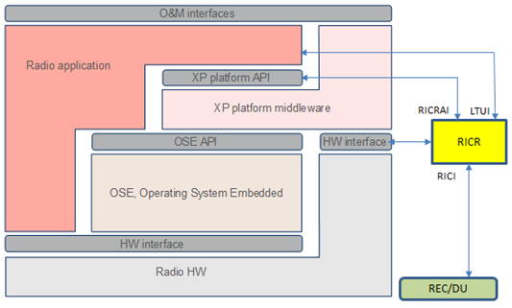
Radio application, middleware and OS
/proj/crbs/radiosw/twh/tools
…/radiosw/external
/proj/crbs/radiosw/twh/tools/xp
…/radiosw/external
…/radiosw/sw/app
/proj/crbs/radiosw/twh/tools/ose*
/proj/crbs/radiosw/twh/tools/ricr
…/radiosw/external

Slide 9
Digital ASIC evolution
Platform4
Platform5
mRRUS
Platform5.x
IRU
NGR G1
NGR G2
AAS
Xenon
/Radon
WARP1.7
COLI: warpA warpB
WARP3
COLI: warp3
WARP3.5
COLI: warp3
WARP3.5 x2
COLI: warp:0 warp:1
WARP3.5
COLI: warp:0
iWARP3.5
COLI: warp:0
Xenon

Slide 10
RU legacy naming – 23/1056-HRB 105 600
RADIO_NAME XY BZ
RADIO_NAME | Name Expanded
RUG | Radio Unit GSM
RUW | Radio Unit WCDMA
RUL | Radio Unit LTE
RUS | Radio Unit Multi-Standard
RRUG | Remote Radio Unit GSM
RRUW | Remote Radio Unit WCDMA
RRUL | Remote Radio Unit LTE
RRUS | Remote Radio Unit Multi-Standard
AIR | Antenna Integrated Radio
mRRUS | Micro Remote Radio Unit Multi-Standard
X | #TX | #RX | Duplex mode
0 | 1 | 2 | FDD
1 | 2 | 2 | FDD
2 | 2 | 4 | FDD
3 | 4 | 4 | FDD
5 | 1 | 2 | TDD
6 | 2 | 2 | TDD
7 | 4 | 4 | TDD
8 | 8 | 8 | TDD
A | 0 | 2 | FDD
C | 0 | 2 | TDD
E | 2 | 0 | FDD
Y | RU Platform
1 | 4
2 | 5, 5.2, 5.3
3 | 5 (TK)
Z = Operating Band
0
1
2
3
4
5
6
7
…
33
34
35
36
37
38
39
40
Platform 4
RUL 01 B13
RUW 01 B1
RUS 01 B3
RRUS 01 B9
RRUS 11 B5
RRUS 61 B40B
RRUS 61 B40C
AIR 21 B2a B4p
RRUS 0Z B2
Platform 5
RUS 02 B2
RRUS 12 B3
RRUS 62 B41D
RRUS E2 B29
mRRUS
mRRUS 12 B13
Platform 5.2 FDD:
AIR 32 B4
RRUS 32A B4
RRUS 32 B30
Platform 5.3 TDD:
RRUS 72 B41

Slide 11
RU new naming (examples) – 23/1056-HRB 105 600
RADIO_NAME #Tx#RxXX BZ
RADIO_NAME | Name Expanded
RU | Radio Unit
RRU | Remote Radio Unit
AIR | Antenna Integrated Radio
IRU | Indoor Radio Unit
RD | Radio Dot
#TX | #RX | Random #
1 | 2 | XX
2 | 2 | XX
2 | 4 | XX
3 | 6 | XX
4 | 4 | XX
4 | 8 | XX
6 | 6 | XX
8 | 8 | XX
0 | 2 | XX
2 | 0 | XX
1 | 2 | XX
Z = Operating Band
0
1
2
3
4
5
6
7
…
33
34
35
36
37
38
39
40
IRU
IRU 2242
RD
RD 2242 B4
NGR G1
RRU 2217 B1
RRU 0208 B1 (2Rx)
RRU 2203 B1 (mRRUS)
NGR G2
RRU 2212 B3
RRU 4415 B7

Slide 12
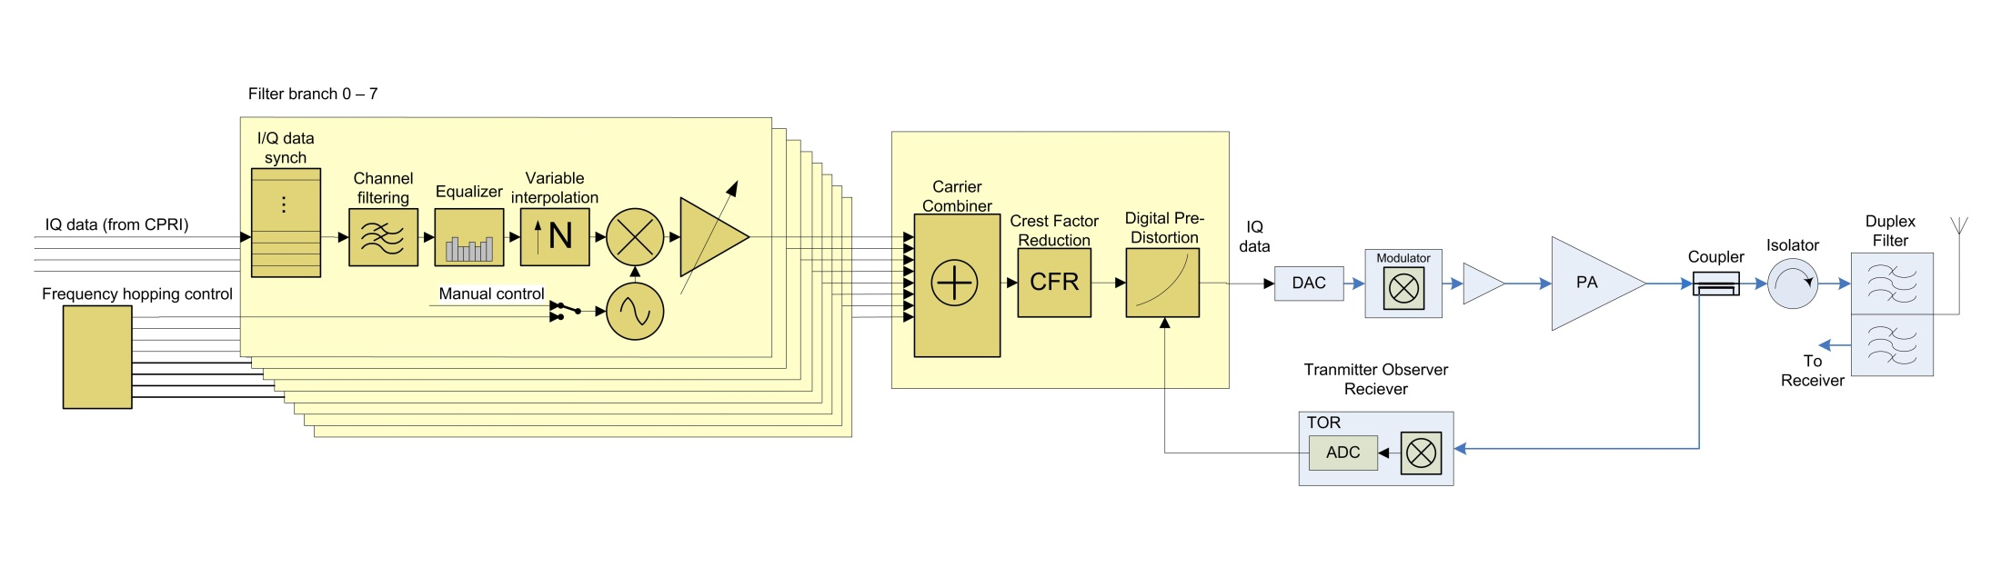
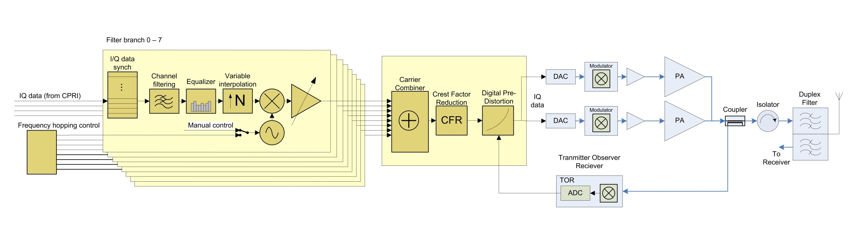
Transmitter
Pre-distortion
function
PA distortion
y
y
x
x
Up-sampling
Clipping limits PAR to 7.5dB
Channel
Filter
EQ
Set frequency
within IBW
Amplify
Up-convert
to RF
Clipping
DPD
PA designed for PAR≤7.5dB
Sync CPRI
Combine
carriers
Digital →
Analog
TXBP
Filter
High signal PAR
=> Doherty PA for good efficiency
WARP
TX
PA
FU
Duplex:
One antenna
TX & RX
IBW Instantaneous Band Width
RF Radio Frequency
TXBP Transmitter Band Pass
EQ Equalizer
PAR Peak to Average Ratio
DPD Digital Pre-Distortion
Adaptive Digital
Pre-Distortion loop
Power control loop

Slide 13
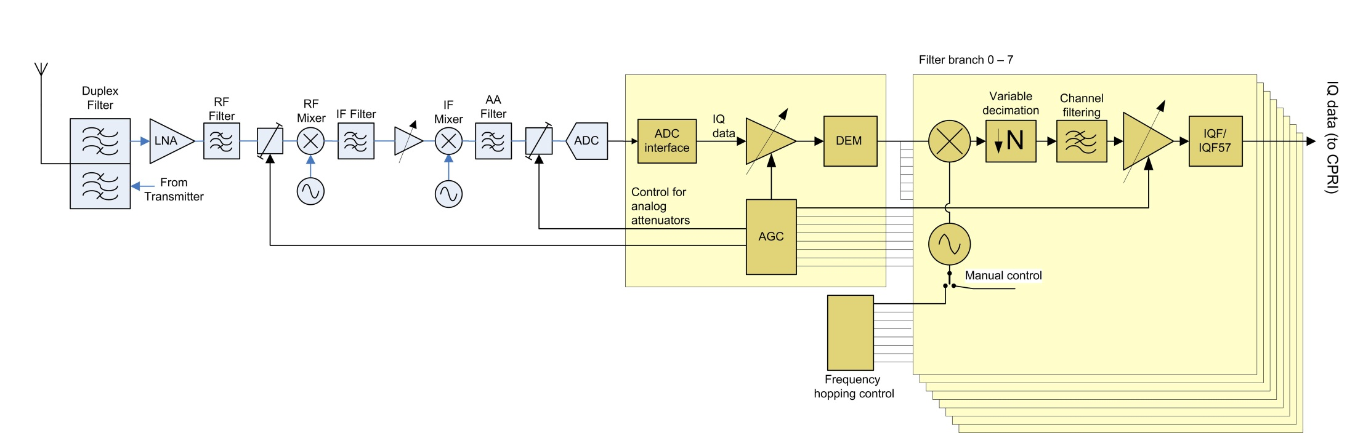
Receiver
Down-sampling
Low Noise
Amplifier
Down Convert
To Base Band
Image Rejection
Filter
Anti-Alias
Filter
Analog→
Digital
RXBP
Filter
Channel
Filter
Demodulate/
Freq translate
IQ Formatting
Down Conv.
Down Conv.
AGC
FU
WARP
RX
VGA
Limited dynamic range in ADC
Duplex:
One antenna
TX & RX
Automatic Gain
Control (AGC)
Gain varies in temperature
Gain spread between units
RXBP Receiver Band Pass
LNA Low Noise Amplifier
RF Radio Frequency
IF Intermediate Frequency
ADC Analog to Digital Converter
AGC Automatic Gain Control
VGA Variable Gain Amplifier

Slide 14
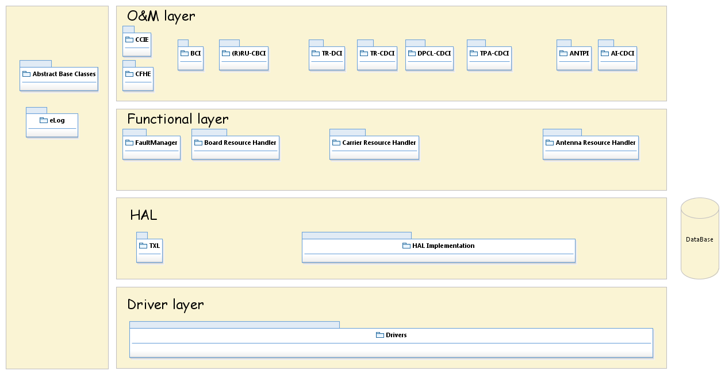
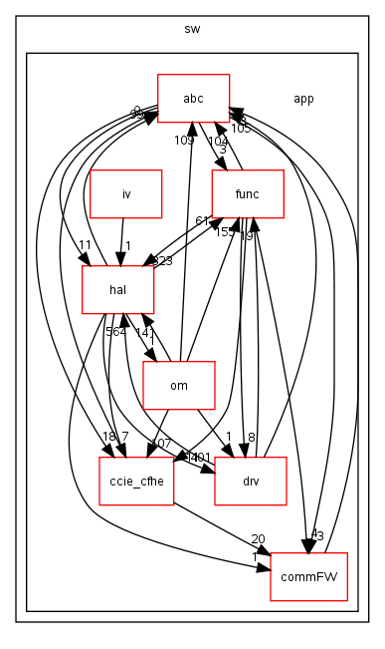
Long Long time Ago…
Common Functions and Radio Control
No layer rules enforcement resulting in
External Interfaces for Radio Operation and Management
Configuration, and resource management
Hardware Abstraction layer. Facilitate HW configuration and Supervision
RICR
XPP
Drivers
Operating system & Services

Slide 15
What is wrong?
Tight coupling of functional blocks
High dependency between different SW components [e.g. TX & RX]
Knowledge of Platform and platform variants are spread across many functional block’s and SW components which results in:
Result complex unit and module testing and integration
Does not foster parallel development
Hard to introduce new features [e.g. SPLC]
SW does not easily scale in response to hardware evolution
Code erosion made it difficult to meet scalability requirement
RF Branch knowledge is hard coded and spread to many SW functions and blocks
Difficult to Maintain
Lack of enforced layer architecture and rules contribute to code being introduced in the wrong layer
Carrier related data is copied and manipulated by different functional blocks
No clear data ownership rules enforced
Rules governing Hal layer isn’t consistent
Some functional blocks call drivers directly [harder to support new HW]

Slide 16
Now
Radio Resources management and coordination
Service Control & Services layers
The focus of modularization

Slide 17
What is New?
Functional encapsulation at each layer
Loosely coupled Layers
Clear architectural guidelines governing the scope and granularity of the SW layers and components
Easy to maintain
Clear and well defined interfaces
Clear data ownership rules
Make scaling of the software easier, in response to the Radio HW evolution
Enforce data driven approach to define the Radio capabilities, Modules cardinality, and the dependencies of the SW modules
Data Driven means that the values are defined in the database and discovered by the services at startup rather than embedded in the SW.
Enforce OO design rules and patterns [Encapsulation and inheritance]
Support Platform 4 and beyond
Facilitate individual module testing independent of the other modules
Allows easier integration of new SW to main track (only need to lock some modules instead of all code during merges)
Notes:
2012-10-19
17
Modularization Overview

Slide 18
More Detail of Layers
Service Control Layer:
The Service Control Layer shall contain the Service Controllers which are responsible to implement and orchestrate logic and events that can be associated with certain functionality. An example of such functionality is Carrier handling, which deals with the allocation and control of radio resources needed to implement a radio carrier.
Service Controllers should have no HW related dependencies or knowledge
Service Layer:
The Service layer shall contain the services which represents the HW-blocks.
The services are strongly associated with the HW they are executing on, but with the aid of the Service Factory Framework, the Services are exchangeable between different deployments.
Ex. PaSrvc for RU configured for TDD will have a different flavor of the service which will be identified in the service DB.
Services have no knowledge or dependency on other services
A service can be shared by multiple controllers, such services are called shared services [e.g. TxLo Service]
Driver Layer:
The driver layer shall contain the drivers for a specific HW and is accessed by the services via the driver interface (HALI1)
Notes:
2012-10-19
18
Modularization Overview

Slide 19
Radio SW Architecture - Requirement and Goals
Supports a large number of HW variants
Enable the introduction of new features and functions with relative ease
Enable parallel SW development
Loosely coupled layers architecture
Functional encapsulation at each layer
Clear and well defined interface
Architectural guidelines

Slide 20
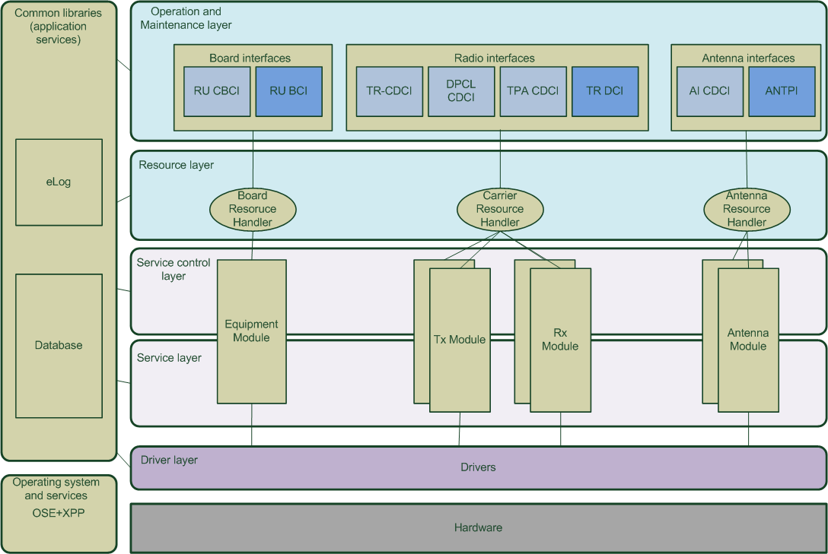
Radio SW Architecture overview
Radio Application Architecture Description
Notes:
Txl SW (TrxCtrl) is included in the Tx Module in this picture, for simplicity reason.

Slide 21
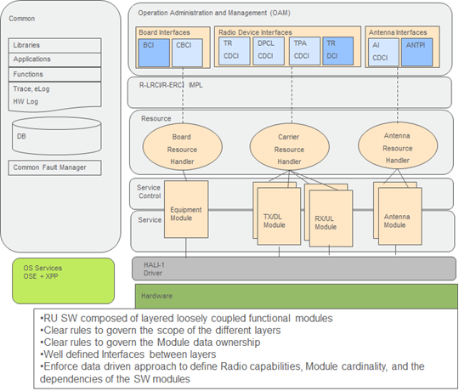
Mapping to SW realization
radiosw/sw/app/commFW/fm
…/radiosw/sw/app/om
radiosw/sw/app/commFW/eLog
radiosw/sw/app/hal/dataBase
…/radiosw/sw/app/resource
…/radiosw/sw/app/tx/serviceControl
radiosw/sw/app/ccie_cfhe
…/radiosw/sw/app/rx/service
…/radiosw/sw/app/drv/hali1
…/radiosw/sw/app/drv
radiosw/sw/app/commFW/activeObject

Slide 22
Layer architecture
Common
Operation Administration Management (OAM)
Board Interface
Radio Device Interface
Common Interface
Antenna Interface
BCI
CBCI
TR
EQMHI
TR
CDCI
DPCL
CDCI
TPA
CDCI
TR
DCI
RMCI
RTFI
AI
CDCI
ANTPI
Libraries
R-LRCI/R-ERCI IMPL
Applications
Resource
Functions
Fault Resource
Handler
Equipment
Resource Handler
Carrier Resource
Handler
File Resource
Handler
Antenna Resource
Handler
eLog, HW log
Service Control
HAL
Equipment
Module
TX Module
RX Module
Antenna Module
DB
Service
LTUI
RICRAI
RICR
Radio Driver Interface (a.k.a. HALI1)
RICI
Driver
OSE+XPP
Or
XCS
Hardware

Slide 23
Radio HW Architecture
RIB
CPU
Digital Front End
Up Conv
TX
Filter Unit
Filter Branch
G
G
DAC
PA
Data1
f₁
DAC
Peak
Circulator
Band Filter
AIB
Filter Branch
G
G
f₀
TX/ RXA
CPRI I/F
f₂
Clipping
G
DPD
TX LO
Bias-T
Data2
Filter Branch
G
G
f₃
DAC
PA
RXA
Filter Branch
G
G
DAC
Main
f₄
ANTP
DGB
DAC
MMI
DAC
VSWR
Digital RX
ADC
TOR
TX/ RXB
FF
TOR
RXB I/O
RX ADC Mod
RX IF Mix Mod
RX RF Mix Mod
LNA
ADC
LNA
From RXB
LNA
LNA
Analog RX
ADC
LNA
LNA
LNA
LTU
LNA
RXA I/O
DC/DC
RXA Out

Slide 24
radio sw functions
Initialize the RU during radio board start-up
Configure RU to support the carriers required by the DU - Digital Unit (BaseBand - BB)
Adjust the configuration as result of environmental or carrier power and/or frequency related changes
Supervise RU operation to ensure the health of components and take any needed corrective actions.
Handles measurements functions, e.g. the transmitted and received radio signal power
Supervise the antenna interface, control the antenna devices.

Slide 25
Device concept
Node
Device id:
Node global identification of a Device Individual in the management interface. It is formed by:
Device Type-Device Individual
e.g ABC-2 (where ABC is the Device Type and 2 is the Device Individual)
Device Set:
All device individuals of the same device type on one device board.
Two different kinds of devices:
Static device:
A Device Individual that which have a fixed address and a fixed capacity. Static devices are created at configuration time.
Dynamic device:
A Device Individual that which does not have a fixed address nor a fixed capacity. Dynamic devices are created during runtime
Subrack
Device
Device Board
(or AU)
Group
Set
Set
Device
Device Board
(or AU)
Group
Set
Set

Slide 26
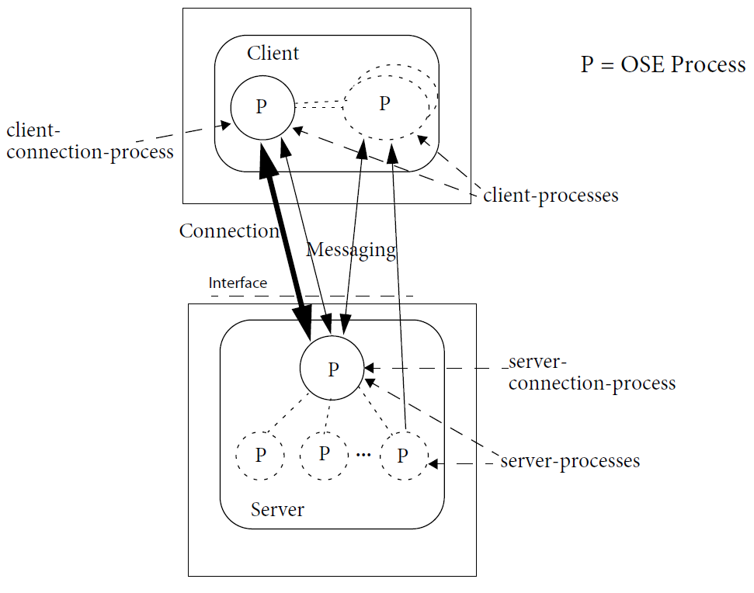
Client and server
O&M is implemented between client and server.
A server provides an interface that the client can use.

Slide 27
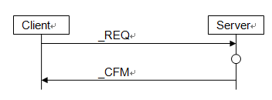
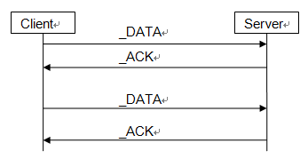
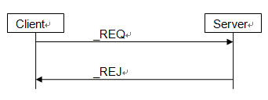
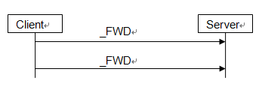
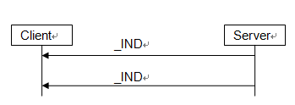
Message between client and server

Slide 28
Multi-client

Slide 29
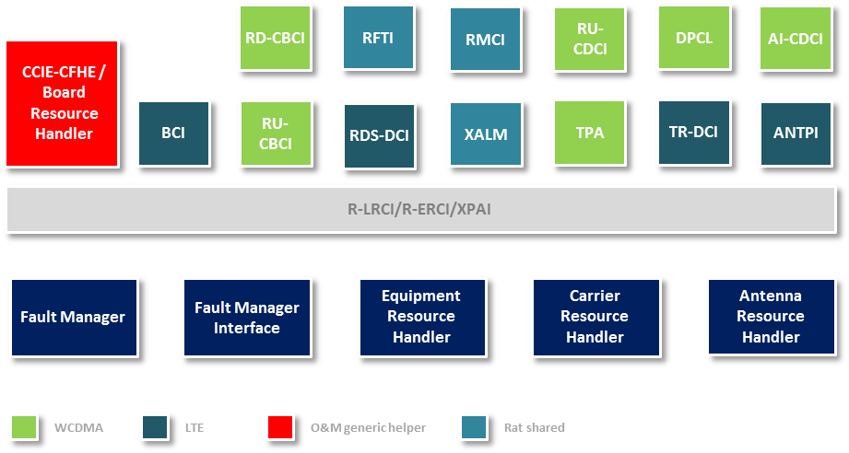
OAM

Slide 30
O&M Layer
O&M
CCIE
Board Interface
Radio Device Interface
Common Interface
Antenna Interface
BCI
CBCI
TR CDCI
DPCL CDCI
TPA CDCI
TR DCI
RMCI
RFTI
AI CDCI
ANTPI
O&M interfaces consist of the following groups:
WCDMA Board and Device interfaces
CBCI (Board Control), CDCI (Device Control) and ANTPI (Antenna Port).
LTE/GSM/CDMA Board and Device interfaces
BCI (Board Control), DCI (Device Control) and ANTPI (Antenna Port).
File transfer interfaces

Slide 31
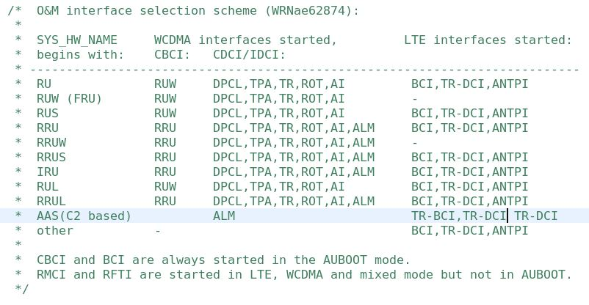
OAM IF Overview
Notes:
1. ROT-IDCI: Inter-Device Control Interface (IDCI ROT) for Raise Over Thermal, used for measurements of the received signal power
2. The DUS G2 (Generation 2) intends to use the LTE-interfaces as a baseline for the WCDMA O&M. This means that the LTE-interfaces will be used for all RAT’s supported by the Radio Unit. There will still be a need to support the legacy WCDMA interface, though.
3. external alarm, measurement (RMCI), and file transfer (RFTI).

Slide 32
O&M LAYER IMPLEMENTATION
Static Processes:
cfhe
bcProc
cbcRuProc
bcLoadHandler
cbcLoadHandler
swStoreHandler
maintStateHandler
ledProc
faultManagerProc
Dynamic Processes:
antpServerProc_
rotProc
trProc
trDcProc
tpaProc
dpclProc
aiProc
almProc

Slide 33
SUBSYSTEM INTERFACE
GSW:...radiosw/external/cache (master)> ls
AI_CDCI_CXA104496_1 RDDCI_CXA1107002_1
ANTPIIFU_CXA104491_1 RDSDCI_CXA1106748_1
DCTRIFU_CXA104492_1 RFTI_CXA1106781_1
DPCL_CDCI_CXA104495_1 RMCI_CXA1106780_1
FU_CBCI_CXA104498_1 ROT_IDCI_CXA104500_1
RRU_CBCI_CXA104502_1 RUW_CBCI_CXA104501_1
RU_CBCI_CXA104499_1 LTUIFU_CXA104493_1 TPA_CDCI_CXA104497_1 RDCI_CXA1106778_1 TR_CDCI_CXA104494_1

Slide 34
Logical devices
An interface is an abstraction of the services provided by a server to one or more clients.
Two interface groups. One used by WCDMA and one used by LTE and GSM.
CDCI and CBCI for WCDMA
DCI and BCI for LTE / GSM

Slide 35
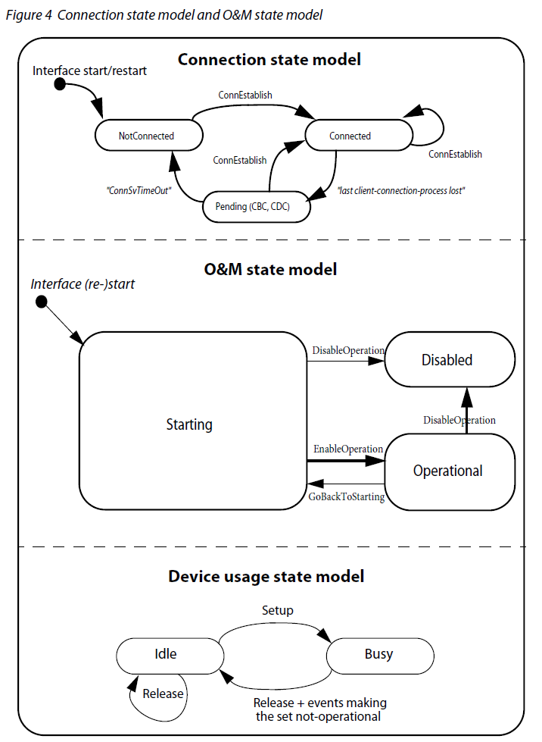
State machine

Slide 36
SINGAL HANDLING
Group signals are handled by CCIE according to Prod_sigset_struct.cc
DEV_SIG will be routed to device to handle

Slide 37
Wcdma interface
CDCI-TR
Manage digital part of carrier related information, measurements and supervision.
CDCI-AI
Antenna interface. Configure and supervise antenna parts.
CDCI-TPA
Power amplifier handling. This interface is mostly legacy and has minimal functionality left.
CDCI-DPCL
Interface for dealing with clipping parameters. Mostly unused on newer radio units. Legacy interface.
CDCI-ALM
Alarm handling
CBCI-RU
Radio unit board interface for ”classic” and RUWA units.
CBCI-RUW
Radio unit board interface for RUW and RUS units.
CBCI-RRU
Radio unit board interface for RRUW and RRUS units.

Slide 38
Common signals
Common Signals for group
XXX_GET_GROUP_CAPABILITY_REQ/CFM/REJ
Common Signals for devices
Generic O&M Functions
XXX_CONN_ESTABLISH_REQ/CFM/REJ
XXX_GET_DEVSET_CAPABILITY_REQ/CFM/REJ
XXX_AUDIT_REQ/CFM/REJ
XXX_GO_BACK_TO_STARTING_REQ/CFM/
XXX_WARM_RESET_REQ/CFM/
XXX_ENABLE_OPERATION_REQ/CFM/REJ
XXX_DISABLE_OPERATION_REQ/CFM/REJ
XXX_SUBSCRIBE_FAULTS_REQ/CFM/REJ; XXX_FAULT_IND; XXX_FAULTCEASE_IND
Device O&M Functions
XXX_CONFIG_ADDRESS_REQ/CFM/REJ
XXX_GET_DEVICE_CAPABILITY_REQ/CFM/REJ
XXX_SETUP_REQ/CFM/REJ
XXX_RELEASE_REQ/CFM/REJ

Slide 39
example
Radio start up and carrier set up
Refer to FD O&M WCDMA CDCI, 3/155 16-CRH 109 0446 Uen

Slide 40
CCIE
CCIE : Common Communication Interface Engine
The entry point for all signals received in the Radio Unit.
Handles connections between both Node Control (LTE) and Main Processor (WCDMA) to the radio.
Implement a “state machine” who keeps track on clients interface state.

Slide 41
ccie
These common parts for the interfaces are handled by the CCIE (Common Communication Interface Engine).
CCIE is a class library which each interface need to instantiate to be able to communicate with the outside world.
Each interface also need to register all signals, that should be accepted by the interface, with CCIE.
If the client sends a signal which is not registered. This signal will be ignored by the radio.
*) The CDCI interface is divided into 5 sub interfaces which, if used, each has its own CCIE instance
Client (DU/MP)
LTE/GSM
WCDMA
BCI
DCI
ANTPI
CBCI
CDCI*
IDC
RU SW
CCIE
RU HW

Slide 42
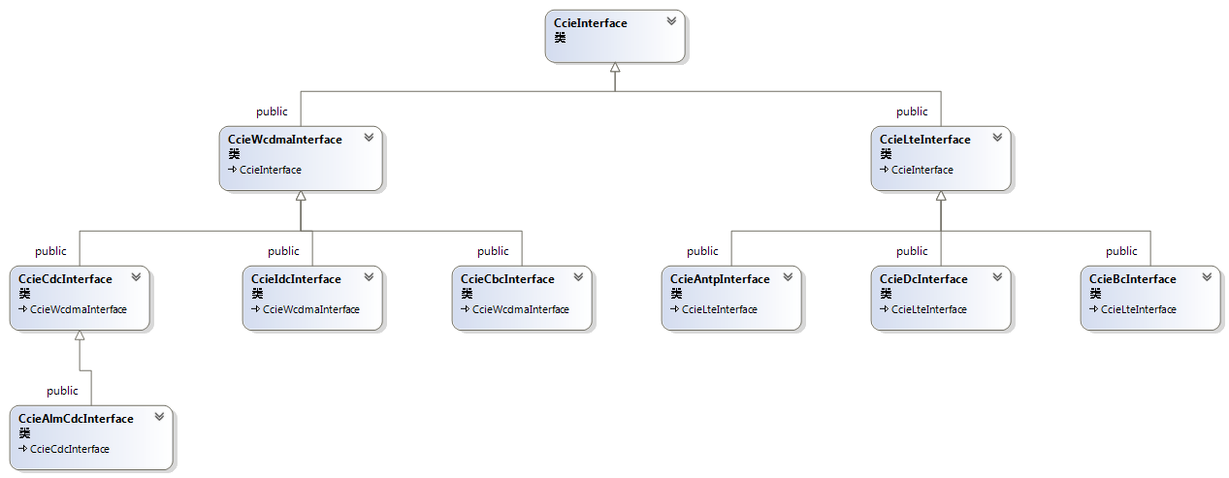
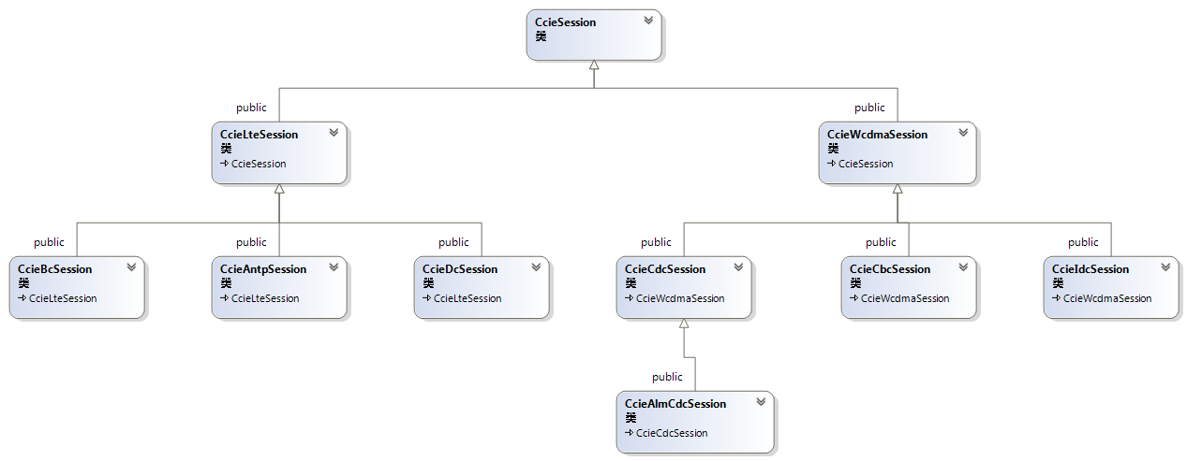
Ccie class

Slide 43
Ccie session – multi client
DUL
DUG
DUW
RU
ccieBcInterface
ccieBcSession
ccieBcSession
ccieCbcInterface
ccieCbcSession

Slide 44
BCI
The main functions of the Board Control Interface (BCI) are:
Load module handling
Board state handling
Board temperature reporting
Control and reporting of MMI LEDs and button
HW log read/write/erase
Board-level fault reporting
Triggering of board restarts

Slide 45
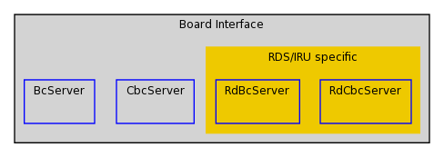
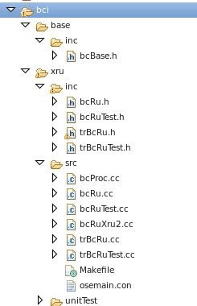
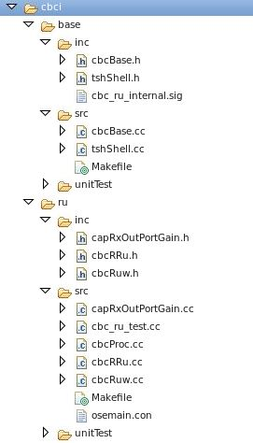
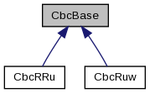
BCI: Board Control IF
Notes:
1. bcBase is a emporty class, not impl, instead bcRu is acting as base or main server class. trBcRu used for support new IF TR-BCI used by AAS product.
2. Cbci has two variants, including RUW-CBCI and RRU-CBCI. Both of them inherited from class ’CbcBase’

Slide 46
DCI
The main functions of the Transceiver Device Control Interface (TR DCI) are:
Radio capability reporting (output power, frequency range, internal bandwidth, number of carriers, etc…)
Carrier setup and modification including power, frequency, bandwidth, time alignment and I/Q streams settings
Handling of antenna port characteristics
Cross-connect port setup and supervision
Device-level fault reporting
Configuration of RF-ports

Slide 47
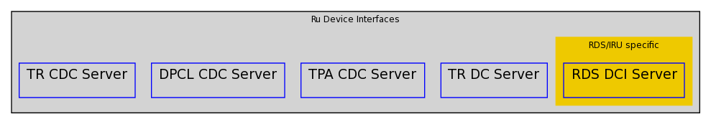
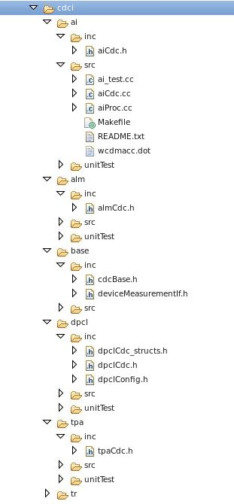
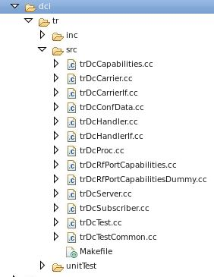
DCI: Device Control IF

Slide 48
Dci device states
DCI State

Slide 49
Antenna IF
The main functions of the Antenna Port Interface (ANTPI) are:
Antenna port capability reporting (voltage, supervision, modem, supported antenna line devices)
Control of voltage and modem
Connection with antenna line devices TMA or RET
Sending data to antenna devices
Antenna system supervision and fault reporting

Slide 50
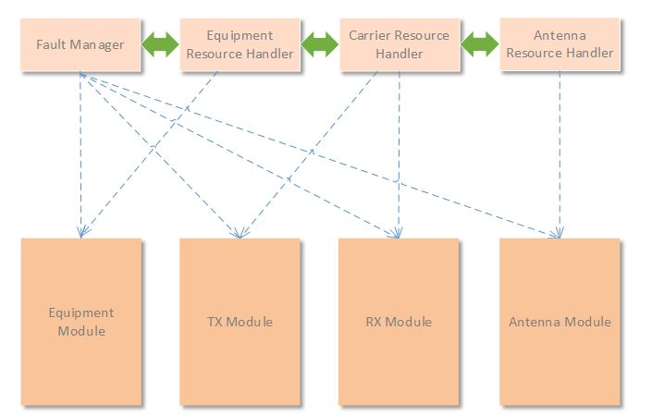
Resource Layer
The intention with the Resource layer is to create an inter-module information highway (the modules are not allowed to communicate directly), where the components can pass information between each other and that is needed for the modules.
The Resource layer contains components with hardware independent logic and these components are intended to have a synchronization and orchestration role in the Radio Application. The items to be orchestrated are the different modules, with respect to global events coming from the O&M layer (DU signaling) or to distribute events originating from the modules

Slide 51
Resource Layer
Fault Manager
Equipment Resource Handler
Carrier Resource Handler
Antenna Resource Handler
Equipment Module
TX Module
RX Module
Antenna Module
Contains the hardware independent logic
Takes synchronization and orchestration role in the Radio SW
Notes:
The dashed line are implemented as e.g. Tx/Rx broker.

Slide 52
Event Subscriber Framework
The Resource layer components communicate using event subscriber framework
The users subscribe to certain events and when these events occur, the subscribers are notified.
The Carrier Resource Handler is (currently) the owner of the framework
Other components will subscribe for the events.

Slide 53
Controller, Service, Driver
Implements the Module SW interface and provides the logic and orchestrates the events associated with certain functionality.
Responsible for initializing the appropriate services
No dependencies on Platform or HW variants
Can be used as a common component by several controllers.
Exports functionality realized in HW.
Exchangeable between different deployments.

Slide 54
Service Framework
Service framework provides infrastructure that provide a module with the following:
Service Factory: Provides the service creation framework -data-driven based-
Service Container: Provides the framework for service registration and lookup

Slide 55
Service Database
Module services creation are Database driven. Service definitions are located in the serviceSet DB.
/xxx/mmServices key defines the list of the mmModule services for a specific platform
mm refers to the module type e.g. tx, rx, etc…

Slide 56
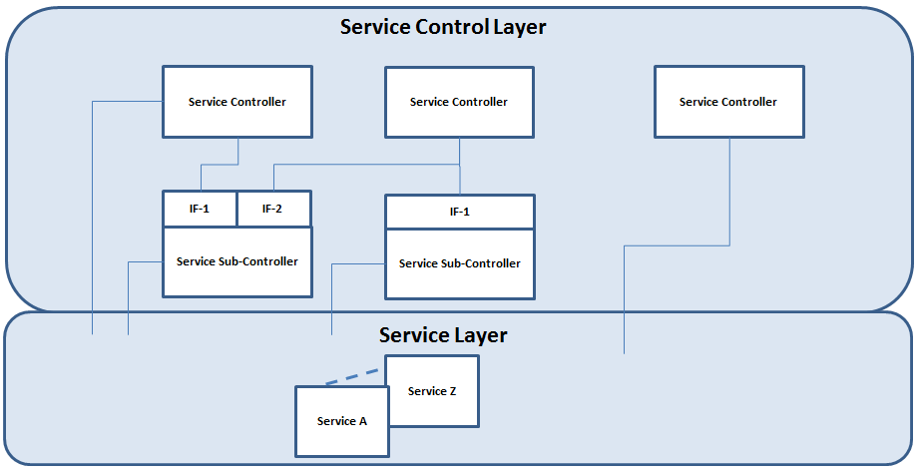
Service Control Layer Service Layer
The Service Control Layer contains the Service Controllers which are responsible to implement the module interface –to provide upper layers access to the module- and orchestrate logic that can be associated with certain functionality.
The Service layer contains the services which represents the HW-blocks and are strongly associated with the HW they are executing on. An exception to this is the coordination service, which has no direct association with the hardware.

Slide 57
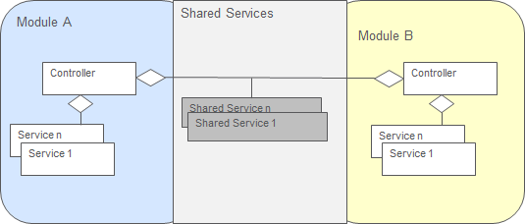
Shared services
Shared services operate via broadcasting of events to the subscribing controllers -the Controllers subscribe to shared service events at initialization time-.
There are two types of shared services. One to serve a HW block shared between two or more modules of the same type [group of Modules]. And the second type is coordination services to coordinate between multiple modules cycles and prevent deadlocks.

Slide 58
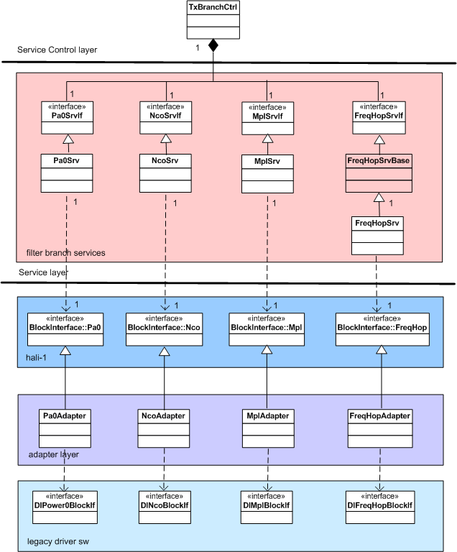
Module (old hali1 IF)
../sw/app/tx/serviceControl
../sw/app/tx/service
../sw/app/drv/hali1
../sw/app/drv/hali1/blockInterface
../sw/app/drv/blockInterface

Slide 59
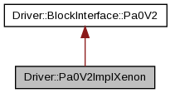
Module (New Hali1 IF)
../sw/app/tx/serviceControl
../sw/app/tx/service
../sw/app/drv/hali1
../sw/app/drv/hali1/blockInterface
../sw/app/drv/blockInterface

Slide 60
New struct
Service 1
Service 2
Service layer “The functions”
Driver interface (Resources)
Driver 1
Driver 2
Driver 3
Driver layer “HW Access”
HW interface
Device 1
Device 2
Device 3
HW
The driver layer handles device access and publishes logical resources.
The services can concentrate on configuring and using the resources rather than the devices.

Slide 61
New struct
The driver layer is executing in the context of the calling process and the interface is synchronous method calls.
Driver interface access normally completes quickly.
What to do, with which resource and when to do it, is all up to the services.
Supervision, compensation, fault handling and power save are all functions in the service layers. The driver layer provides the means through which you can realize these functions.

Slide 62
Driver layer
The purpose of the driver layer is to identify the HW, start the correct device drivers and provide access to the HW through a well specified interface.
We have a collection of device drivers for physical components.
A device driver is generally platform independent and heavily parameterized (Database) to be reusable on any board.
The driver interface hides the device type and device topology from the user.

Slide 63
Driver Layer
What is not handled by the driver layer?
No protection to avoid dangerous settings (e.g. gain or voltages).
No mechanisms to make sure that we use resources in the correct order to achieve a function (e.g. Rx Gain, Clipping)
No sequences of timed operations on resources.
No arbitration between users that do not agree.

Slide 64
Driver Layer Cont.
Sensor objects
Blocks
Control objects
Switches
Upper Tier:
Interface objects mapped to the device drivers
Common names
RAW values are converted to human readable values
Lower Tier:
Device drivers arranged in a dependency hierarchy
Memory mapped ASICs and FPGAs at the bottom.
Slave devices above bus masters.
Upper Tier
Synth
ADC
DAC
GPIO
SPI
GPIO
Warp
FPGA
Lower Tier
Service Ctrl
Service
Driver
HW

Slide 65
Useful Links
RP Radio SW Ericoll
RSW XFT Visualization
Radio Functional Descriptions (FDs) 155 16-CRH 109 0446
Radio Design Documents (DDs) 159 61-CNH 160 6510
Radio Application AD
Doxygen
PD Radio SW WIKI
Acronyms

Slide 66
Database view

Slide 67
The purposes of databases
Main objective
The general purpose of these parameters is to provide possibilities to calibrate, initialize, configure, control, compensate, supervise, measure and report the radio units.
How to interact with radio’s hardware
eg whether to use I2C, SPI, or memory mapped I/O
Hardware configuration settings for particular states
eg temperature correction tables
Decision points for triggering certain actions
eg when to report a voltage fault
What functionality the hardware supports
eg what RATs are supported
The other purpose of the database parameters is to handle different variants of radio HW using the same software regarding internal handling and handling in the interfaces towards the clients..
Advantages
Simplifies software code
Avoids hard coding values in software
Easier to update databases files than to modify code
Enables hardware and systems teams to make changes without having to modify code

Slide 68
the database
The Database (DB) is a collection of parameters which contain the information needed to start and run the SW for a specific Radio HW.
There are SW and HW (Production, PA) databases.
HW DB for calibration data and unit specific parameters
SW DB for design parameters
All databases are merged into one runtime database.
Runtime DB
SW DB
/board/trxDrivers/set char "420"
/board/paDrivers/set char "206"
/420/trxDrivers char "ruwaCsc xppGenIO dcOkSv 2_5V_OkSv ", "warp blockIf warpGenIO spiMaster ", "spiHub ltu10 i2cMaster i2cHub fpgaS90"
/5xx/trxFpgaAiSpiMaster/type char "TrxFpgaSpiMaster" /5xx/trxFpgaAiSpiMaster/deviceTag char "fpga" /5xx/trxFpgaAiSpiMaster/intProcTag char "trxFpgaIntProc" /5xx/trxFpgaAiSpiMaster/regOffset U32 0x300 /5xx/trxFpgaAiSpiMaster/maxNumSlaves U32 2
Hardware DB
Prod DB
PA DB

Slide 69
Database example
Key
Parameter
Value
/5xx/trxFpgaAiSpiMaster/type char "TrxFpgaSpiMaster" /5xx/trxFpgaAiSpiMaster/deviceTag char "fpga" /5xx/trxFpgaAiSpiMaster/intProcTag char "trxFpgaIntProc" /5xx/trxFpgaAiSpiMaster/regOffset U32 0x300 /5xx/trxFpgaAiSpiMaster/maxNumSlaves U32 2 /5xx/trxFpgaAiSpiMaster/bitInIrqReg U8 30 /5xx/trxFpgaIntProc/type char "DeviceIntProcManager" /5xx/trxFpgaIntProc/deviceTag char "fpga" /5xx/trxFpgaIntProc/irq U8 18 /5xx/trxFpgaIntProc/trapReg U32 0x8001 /5xx/trxFpgaIntProc/maskReg U32 0x8000

Slide 70
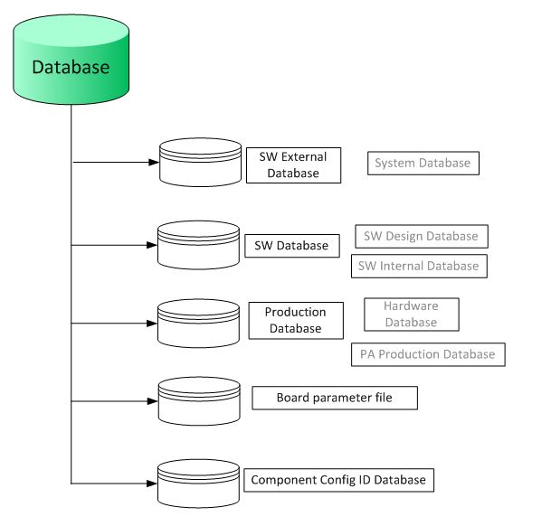
DB overview
Notes:
The external database – often simply called SW external database – with the term “external” is seen from SW point of view and refers to the fact that the database files are provided in txt-files outside of the actual radio SW.
The production database should only have parameters that is changing on a per unit level. The production database is divided into two parts
Configuration part
Calibration part.
The content of the production database is written into flash memory of radio hardware during production phase, The configuration part is handling information about power class frequency ranges and so on. The calibration part handles production calibrated values such as gain and frequency correction tables.
*** The production database entries override software database entries with same base name. They cannot be changed after radio units are delivered to customers without a new revision of product.***
The production database and PA production database are also called hardware database (or HW database) since their parameters are written into the radio hardware.
The PA production database shall be loaded to EEPROM. It shall contain powClass, Idq (DPA and Mpa bias), Address, channel and sub channel to all PA components that is digitally controlled - basically all other things that is not placed in the PaSwDb.txt which is part of external database.
The Board parameter file is essentially one file per xRU platform containing parameters controlling the XP platform by describing the HW environment via parameter values.
The component configuration ID database is part of the external database (the external database consists of SW external database and the component configuration ID database.) and consists of 14 files managed by radio HW design team.

Slide 71
Owner
SW Int Databases
Part of software in PIS and App load files
Content managed by SW team and be modified after radio delivered by build a new .xlf load
SW Ext Databases
Content managed by hardware and system teams
Production Database and PA Database
Content managed by hardware and production teams
Board Parameters
Not strictly a database but serves similar purpose so mentioned here
Content managed by hardware and production teams
Component ID databases
Updated frequently by each new product
Content managed by hardware and SW (board and system) teams

Slide 72
DB FILES
Database | Database files | Comment
External database Also called SW external database | Clipping.txt dlFilterCoef.txt dlPcFilterCoef.txt gpp3.txt hotSpot.txt paSwDb.txt rxCalib.txt rxFrontEnd.txt sysDataParam.txt tddSwitches.txt temperatureSupervision.txt timing.txt trxPhases.txt txSwDb.txt ulFilterCoef.txt ... ... | Description see chapter 3, can be found in GIT
Database | Database files | Comment
SW internal database Also called SW design database | board.txt channels.txt deviceDrivers.txt driverSets.txt functional.txt protoDbKeys.txt serviceSet.txt supervision.txt | Description see chapter 3, can be found in GIT
Database | Database files | Comment
Production database | Example: Database Update Description RRUS72 B40T, 152 12-KRC161411/1 Board section IQ Start Values DPD Nominal Power & Clip Set Downlink Delay TOR TrxCtrl Rx Calibration Board Parameter updates | Specified in 152 12-KRC spec for each RU product, template file can be found in GIT

Slide 73
DB FILES
PA Production database | pa_typex_production_Db.txt | Can be found in GIT (not in repo). The wildcard “x” can be one or more characters.
Board parameter file | x_board_para.txt | Can be found in GIT (not in repo). The wildcard “x” can be one or more characters.
Component configuration ID database | aibAdc.txt dpdDevice.txt filterType.txt lna.txt lnaModule.txt ltuModule.txt ram.txt rxAdcModule.txt rxCtrl.txt rxIfModule.txt synth.txt torModule.txt txDac.txt txModule.txt | Specified in 15212- spec for each RU product, template file can be found in GIT (not in repo)
External DB access guidance specified in EAB-14:043436

Slide 74
Db content
Software searches for base name and uses the key to select which particular parameter to use
For Board Parameters, there are no keys. Radio has one and only one database parameter for each base name
More information on keys is available in the RU DB Design Rules document
The same base name may exist in the Software design database and the Production database but could have different values.
RULE NR.1 : Production DB always overwrite SW DB value if same base name used.
They cannot be changed after radio units are delivered to customers without a new revision of product.
clipping.txt
Key Segment
Base name
Type
/set4/lte2/pcThreshold U16 67
/set4/lte14/pcThreshold U16 67
Parameter
Value

Slide 75
Database content
Database File
Key
Segment
Clipping.txt
/set4/lte2/pcThreshold U16 67
/set4/lte14/pcThreshold U16 67
/set4/lte30/pcThreshold U16 67
/set4/lte50_25/pcThreshold U16 64
/set4/lte100_25/pcThreshold U16 64
/set4/lte50/pcThreshold U16 64
/set4/lte100_50/pcThreshold U16 64
Parameter
Base name
Type
Value
Software uses the key to select which parameter to use
The value from the HW database overrides the value from the SW database if the keys are equal
For Board Parameters, there are no keys. Radio has one and only one database parameter for each base name

Slide 76
Driver set
Only a number in production data base (A key to find correct info)
What drivers that shall be loaded corresponds to driver set is within SW
Two driver sets exists one for PA and one for TRX
e.g. /board/paDrivers/set "600"
/board/trxDrivers/set "601“
What parts of the SW database that shall be loaded also corresponds to a key in the production database
Example /431/ id_ruType_x.x.x
It as a function in SW that looks up all database values that have to be loaded on the particular HW. Based on driver set and band info.
In SW the Key can fit into following
/4XX/id_ruType_x.x.x This can be read as loading parameters for all driver sets that starts with 4 and is of one ru type
/43X/ id_ruType_x.x.x This can be read as loading parameters for all driver sets that starts with 43 and is of one ru type (If this exists it is chosen higher prio than above)
/431/ id_ruType_x.x.x The specific driver set 431 shall be used together ruType parameters (If this exists it is chosen higher prio than above)
Eg. In case that some database parameters need to be modified for bug fix or testing or trouble shooting, the wildcard x may take a specific value 0 or 1 or onwards; while the other database parameters are not concerned and still used the wildcard x.
RULE NR.2 : Software chooses more specific applicable entry over more generic entries.

Slide 77
Driver Set
Driver Set – a unique numerical identifier for a specific type of HW from a SW point of view.
The same Driver Set can be used for many KRCs.
A 3 digit number:
Driver List – the drivers to start given a specific Driver Set
/422/trxDrivers char "... xppSpiMaster warpSpiHub lnaAdc ..."
4 2 2
Platform
Variant
Product Platform

Slide 78
parameter priority
Type of RU specified in production database
Software chooses more specific applicable entry over more generic entries
Default value of 0 will be used if none of the other entries are applicable
/parameterX U16 0
/4xx/parameterX U16 2
/5xx/parameterX U16 4
/501/parameterX U16 6
/501/BandV/parameterX U16 8
Value of 2 will be used for all platform IV radios
Value of 4 will be used for all platform V radios that are not using TRX driver set 501
Value of 6 will be used for all platform V radios using TRX driver set 501 that are not Band V
Value of 8 will be used for all platform V radios using TRX driver set 501 that are Band V

Slide 79
New DB struct
Driver set tag has limitation and cannot fully be used to identify the product capabilities
Same trx board in both RUS and AIR
Identify product DB param by using ruType tag, new struct introduced in G1.
For product specific parameters complement driverSet by ruType
Product specific parameters includes;
Capabilities (eg. /7xx/id_ruType_1.7.x/capabilityDlBw S32 75000)
Design parameters
Supervision limits
Temperature compensations parameters

Slide 80
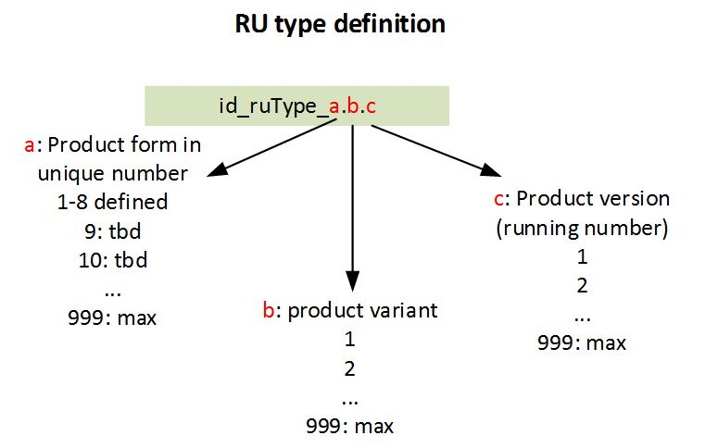
Definition of RU Type
ruType_x.y.z
x: is defined as the variant of RUS, AIR, RRU/mRRU etc.
y: is defined as Product Specific as shown in the IPP.
z: is defined as version of product Specific RU.

Slide 81
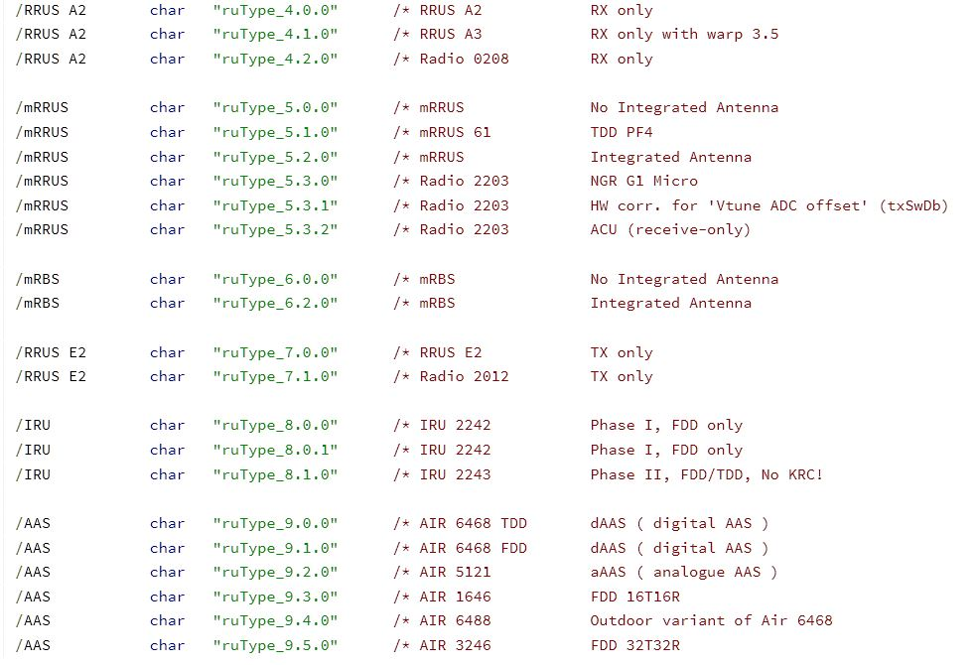
RU Type
RU Types: Example:
0 RU Macro Radio Unit
1 RRU Remote Radio Unit
2 AIR Antenna Integrated Radio
3 RIR Repeater Interface Radio
4 RRUS A2 RX only unit, Remote Radio Unit
5 mRRUS micro Remote Radio Unit SDR
6 mRBS micro RBS
7 RRUS E2 TX only unit
8 IRU Indoor Radio Unit
9 AAS Active Antenna System, analog & digital

Slide 82
FILE REPO
Include all product specific files into the existing repository to the related common file.
e.g all product specific files for timing function will be placed in the same repository as TimingParam.txt

Slide 83
DL db
clipping contains
Peak-clipping thresholds for radio units of different RATs and power classes
Parameters for the rules specified in downlink performance control
dlFilterCoef contains
DL filter coefficients for various carrier types. The values are measured for various numbers of filter taps depending valid sample rates. There is no product-specific parameter file
dlPcFilterCoef contains
Filter coefficients of peak filters of clipping functions in CFR (Crest Factor Reduction) in the downlink. The values are measured for various numbers of filter taps depending valid sample rates. There is no product-specific parameter file
paSwDb contains
Data about supervision limits of currents, voltages and temperatures for PA control
The values have to be updated before connecting PA and TRX

Slide 84
Ul db
rxCalib contains
Data for the receiver part about AGC-related parameters, spectrum rotation, configuration parameters.
The values have to be updated after necessary measurements before connecting PA and TRX.
rxFrontEnd contains
Data for supervision limits of LNAs in different frequency band variants and also TDD mode.
The values have to be updated after necessary measurements before connecting PA and TRX.
ulFilterCoef contains
UL filter coefficients for various carrier types. The values are measured for various numbers of filter taps depending valid sample rates. There is no product-specific parameter file

Slide 85
Comm db
sysDataParam is the most extensively used file containing parameters in
Capability parameters
Configuration and compensation parameters
Owned by system, shall be updated by system
timingParam contains
Parameters used for the whole system to get a correct timing in the radio signaling, such as various delays, sub delays and fine delays in the downlink and uplink chains and for frequency bands.
The values is updated after necessary measurements before RPV (radio performance verification)
The design of database parameters follows
certain rules including the modification of existing database parameters or adding new database parameters. These rules are specified in the design rule document [RU DB DR].
Notes:
Cap: RF port filter branch
Data port
Reporting
TX/RX bandwidth
No of TX or RX ports
Duplex mode
Sub band / full band support,
PAR (peak-to-average ratio)
GSM IPM capability
TX port minimum output power and dynamic power range
Cross connect, Co-site ports
HW performance
Supported carrier types, additional carrier types, and RAT :/id_ruType_1.5.0/Band0/supportedRat char "W L"
HW specific aux voltages capabilities
Available antenna port
Number of static devices reported over the ANTPI
Conf:Bandwidth information
Filter branch usage information
Frequency offsets for NCO
Internal data link usage
DL and UL data interface sample rate and sub sample definitions
DL carrier power default values for compensation and definition of the scaling of baseband signals per carrier type
Internal data rate at carrier combiner
Samples per symbol in LTE phase compensation
MPL settings (0.1dB) relation to 2914
MPL maximal allowed (0.1dB) gain for WCDMA
Required power reduction (0.1dB) at Normal to high temp
Equalizer parameters
Sub band related parameters
Seamless Power Level Change (SPLC) parameters
Frequency hopping support parameters
WCDMA band specific aux voltages
Antenna Voltage supervision limits

Slide 86
stub
Often seen in temporary db files used in early phase dev when real db is not ready or exist
With Key 431/B20
stub/431/B20 will be chosen before values such as 43x/B20 or 4xx/20
stub/4xx/B20 will never be used if 431/B20 or 43x/B20 exists

Slide 87
DB Coli
Modify prod db value:
$ db write /board/trxDrivers/set -c 551
$ db write /board/paDrivers/set –c 701
$ db prod copy
$ db prod save /board/paDrivers/set
Adding new DB entry
$ db add
$ db resize
$ db write
Delete DB enter
$ db prod del /tor/txA/10W/freqCorTabNoFilter save

Slide 88
DB Coli
Useful commands
Listing Board Parameters (whole db txt will be printed here)
$ par get
Listing Production Database
$ db list prod
Lisitng PA database
$ db list pa
Listing all used databases
$ db list * used
Using wildcarding check which trxDriver set used
$ db list *rivers* used

Slide 89
Resource Names
Legacy Driver Name
“TxTempA”
“Temp”
“A”
TemperatureSensor
“Tx”
InstanceToken
Resource Type
Resource Name
Instance
Instead of embedding the type and instance in the name, we keep them separated.
The name becomes more generic and can be used for resources of different types.
The code is found in radiosw/app/drv/hali1/if

Slide 90
Instance Token
InstanceToken represent Rx and Tx branches (enumeration ’A’, ’B’, ’C’ in legacy or numerical ’0’, ’1’, ’2’ for AAS)
Can only be created inside the driver layer
Startup routine gets a vector of instance tokens from driver layer by calling Driver::getInstanceTokens() in ’hali1config.cc’
The service uses the instance token to get the correct driver
Used when creating resource objects
VoltageSensor vdd(ruError,”Vdd”,instanceToken, reportNotFound);

Slide 91
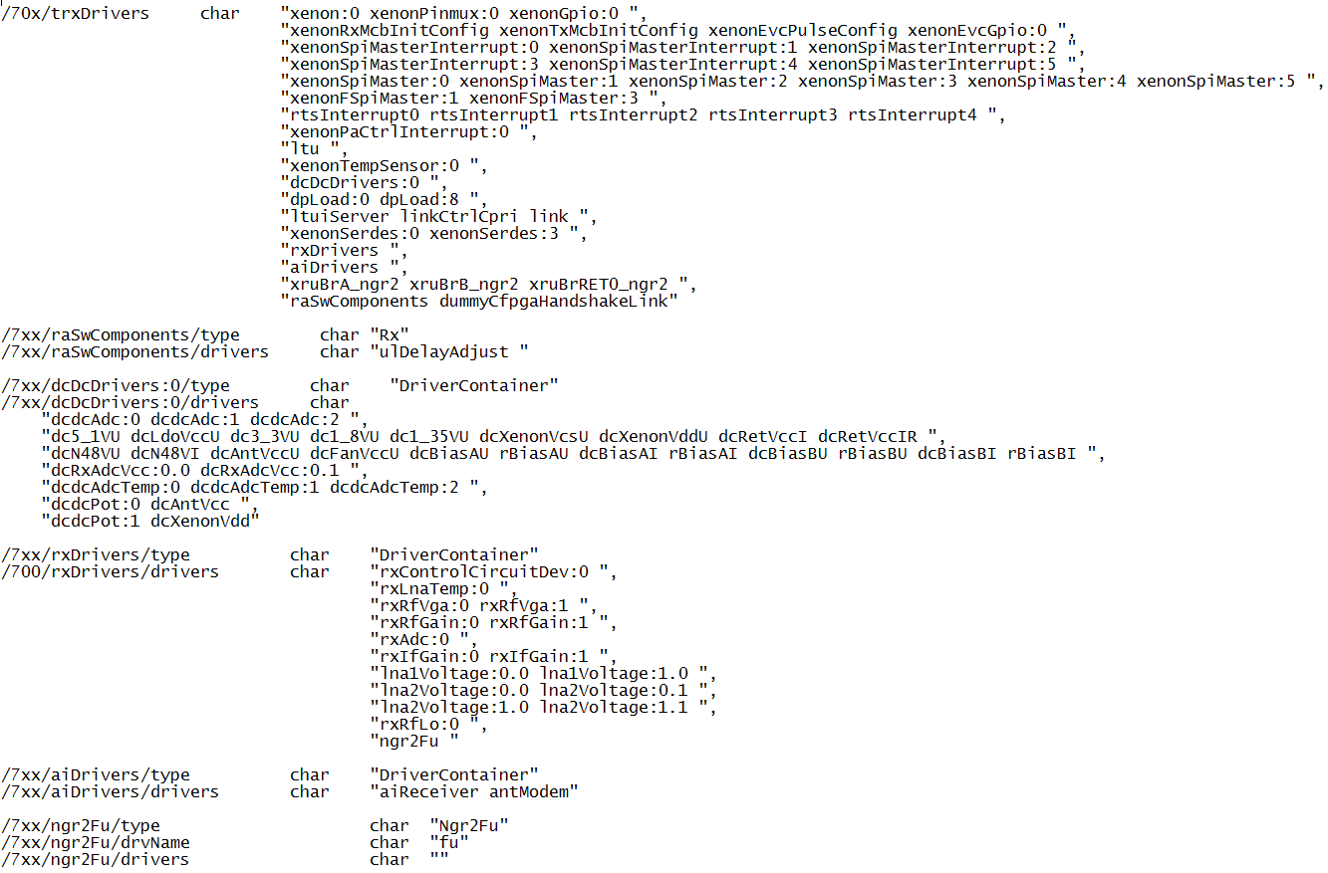
driverSets.txt – sample entries
Driver SW will be started in order they appear in this list
“HW Initialization Completed” after all drivers have been started
SoC-specific DB entry
Notes:
Radio Databases Overview
91

Slide 92
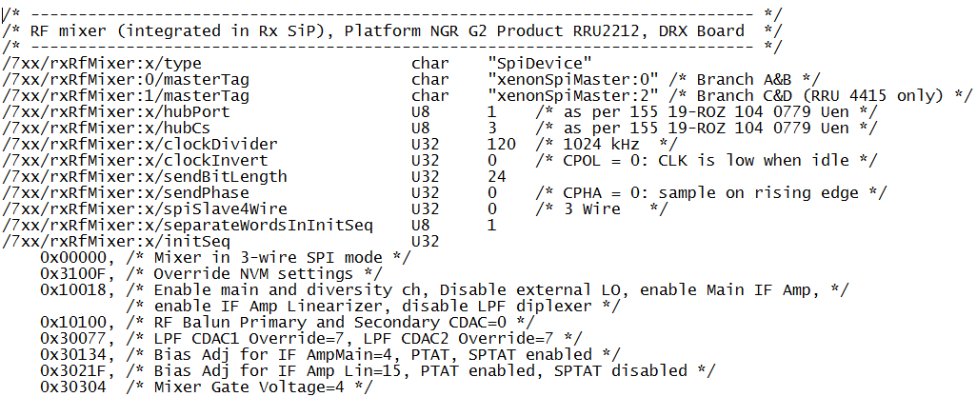
deviceDrivers.txt – sample entries
Generic SPI Driver (code reuse)
SPI Master Driver (shared with other SPI slave devices)
Xenon
(SPI Master)
Hub Port1
Hub CS3
Xenon
(SPI Slave)
Data
Clock
Chip Select
Notes:
Radio Databases Overview
92

Slide 93
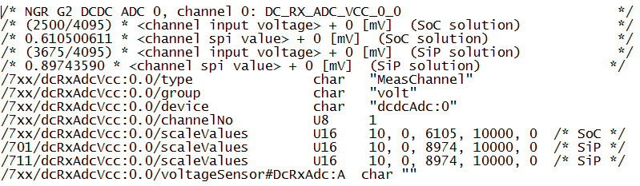
channels.txt – sample entries
volt (voltage), could also be temp (temperature) or curr (current)
Which ADC device
Which channel in ADC device
Parameters used in converstion equation
SiP & SoC use different values
Which equation to use to convert from ADC reading to voltage value
Notes:
Radio Databases Overview
93

Slide 94
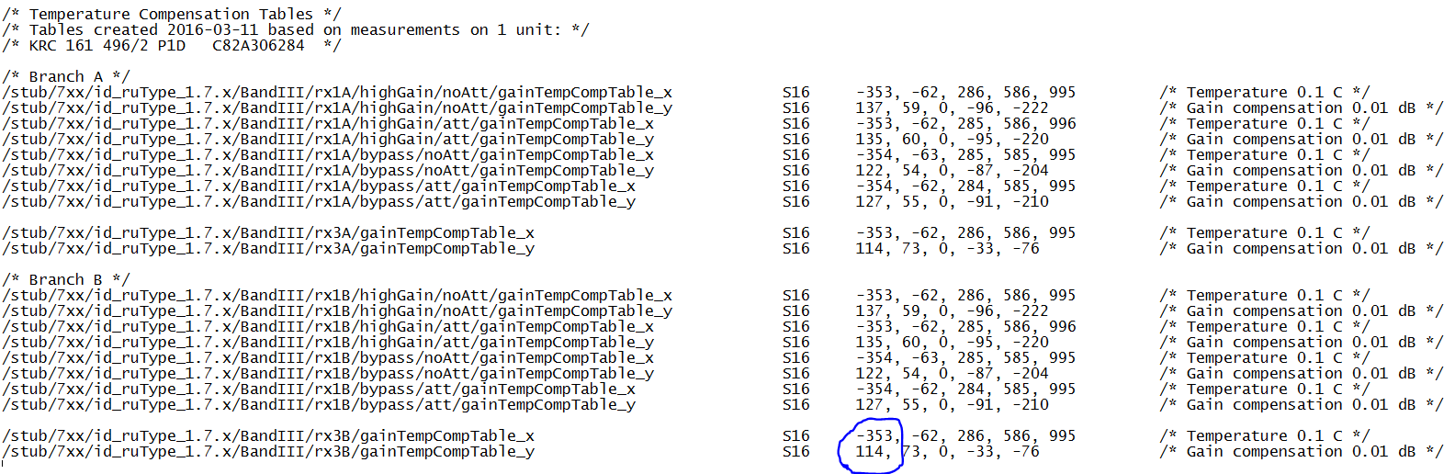
rxCalibRru2212.txt – sample entries
At -35.3 degrees Celsius (as measured at Rx temp sensor), gain for rx3 portion of branch B will be increased by 1.14 dB
SW will interpolate between points
ie it assumes a straight line between each set of values in the table
Y
SW will use this Y value
for this X value
X
Notes:
Radio Databases Overview
94

Slide 95
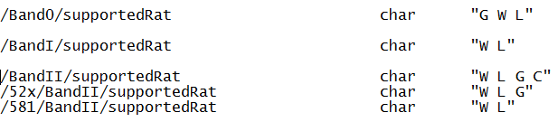
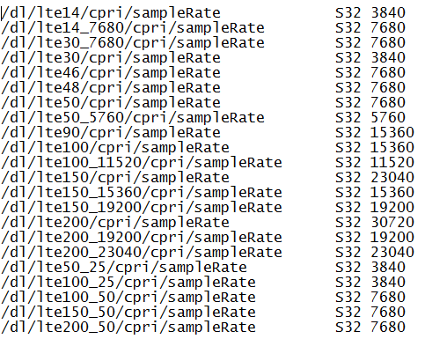
sysDataParam.txt – sample entries
All Band0 radios on all platforms will
support GSM, WCDMA and LTE
All Band1 radios on all platforms will
support WCDMA and LTE
PL5.2 BandII supports WCDMA, LTE and GSM
PL?? BandII supports WCDMA and LTE
All other BandII radios support WCDMA, LTE, GSM and CDMA
An example of DB entries that depend on the carrier configuration:
Notes:
Radio Databases Overview
95

Slide 96
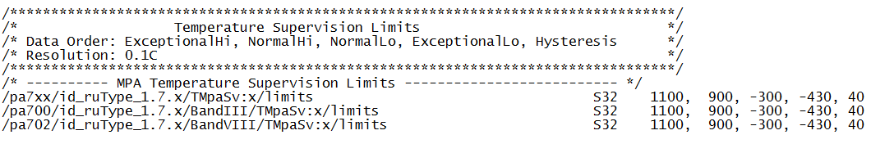
paSwDb.txt – sample entries
PA will be shutdown if MPA temperature exceeds 110 degrees Celsius, Fault will be raised as well
Power level will start to be backed off if MPA temperature excees 90 degrees Celsius
Fault not cleared until temperature drops below 106 degrees (avoids fault toggling)
Notes:
Radio Databases Overview
96

Slide 97
Startup

Slide 98
Radio app startup
Higher layers SW trigger lower layer
-before start themselves
Notes:
::initOmLayer

Slide 99
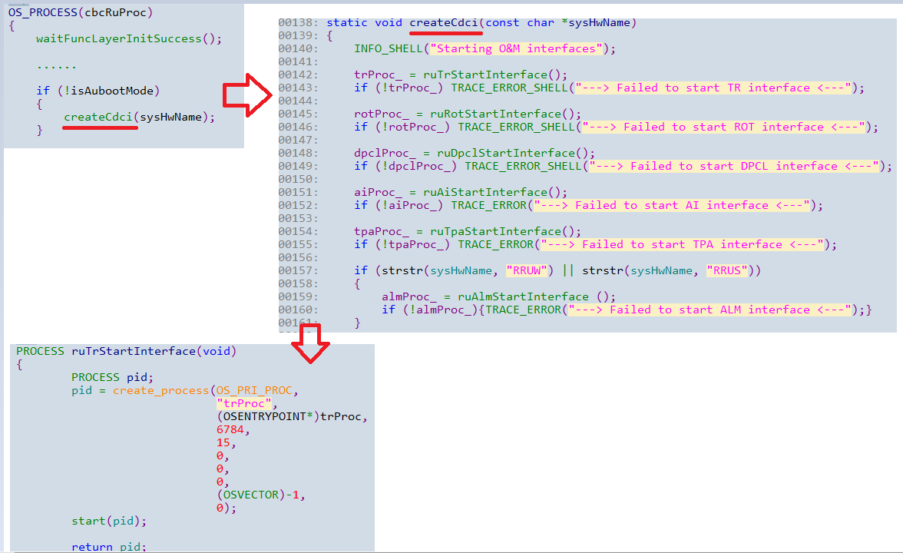
STARTUP OF O&M

Slide 100
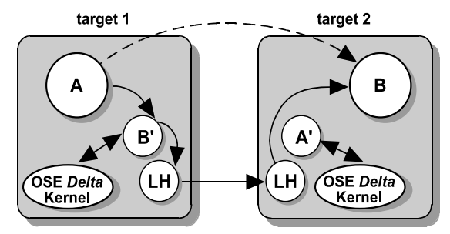
Phantom process
An empty process (does not contain any executable code).
Used to make the communication between processes not residing in the same target as transparent as possible

Slide 101
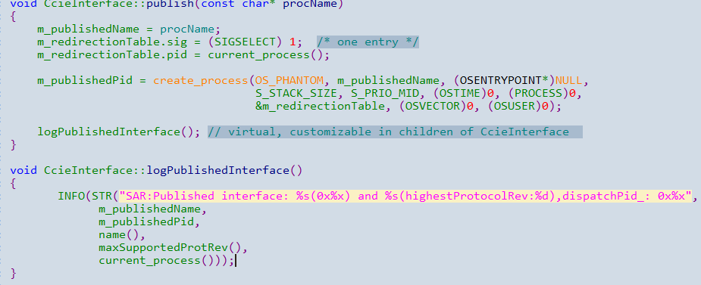
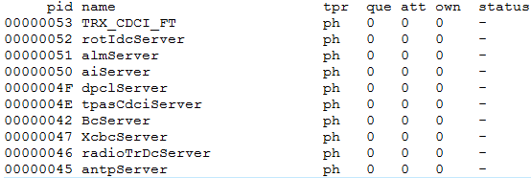
Publish interface

Slide 102
Code:om/startUp/src/startUpProcess.cc
OS_PROCESS(startUp)
{
OMCSF_registerTraceObj_TRACE_OBJ_BCI();
OMCSF_registerTraceObj_TRACE_OBJ_DCI();
OMCSF_registerTraceObj_TRACE_OBJ_ANTPI();
OMCSF_registerTraceObj_TRACE_OBJ_RMCI();
OMCSF_registerTraceObj_TRACE_OBJ_RFTI();
OMCSF_registerTraceObj_AGC_AMPLITUDE_COMP_CONTROL();
OMCSF_registerTraceObj_UL_SUBBAND();
OMCSF_registerTraceObj_TIME_ALIGNMENT_UL();
OMCSF_registerTraceObj_TIME_ALIGNMENT_DL();
OMCSF_registerTraceObj_UL_INTERFERENCE();
OMCSF_registerTraceObj_CLIPPING_DL();
OMCSF_registerTraceObj_UL_FREQ_HOP();
OMCSF_registerTraceObj_UL_DIGITALFILTER();
OMCSF_registerTraceObj_TDD();
OMCSF_registerTraceObj_ZERO_INSERT();
OMCSF_registerTraceObj_TRACE_OBJ_RDBCI();
OMCSF_registerTraceObj_TRACE_OBJ_RDCBCI();
OMCSF_registerTraceObj_TRACE_OBJ_RDSDCI();
OMCSF_registerTraceObj_SV();
OMCSF_registerTraceObj_DATA_COLLECTION();
OMCSF_registerTraceObj_BIN_LOADER();
OMCSF_registerTraceObj_SPI();
OMCSF_registerTraceObj_COLI();
//Create error handler to take care of TMO exceptions
create_error_handler(get_bid(current_process()),
(OSERRH *)block_tmo_error_handler,
200);
initOmLayer();
// startUpTime allows us to collect the time of events in the Startup of the Radio
// so that we can see if new code has am impact on the startup time
// you can set the time using the startuptime shell cmd
startUpTime.ticksInitComplete = get_ticks(); // Startup
stop(current_process());
}

Slide 103
Code:om/startUp/src/initom.cc
bool initOmLayer()
{
bool startupNormal = initFuncLayer(); //startup all driver according to readed driverset, then TX, RX…modules one by one.
if (!startupNormal)
{
return startupNormal;
}
startupNormal = initResourceLayer();
if (startupNormal)
{
RfSignalResourcesIf::init();
startUpTime.ticksInitComplete = get_ticks();
//TR HS50093
om_layer_success = true;
}
return startupNormal;
}

Slide 104
Code: func/source/initfunc.cc
bool initFuncLayer()
{
……
……
if (!::StartUp::init()) // Loads SW & Prod Database. Creates and initializes all device driver objects needed for the actual HW unit.
{
func_layer_fail = true;
return false;
}
// init EQP module
if (eqpStartUpPtr == NULL) // code should only be called once per radio init
{……}
//init TRX share module
if (txRxSharedStartUpPtr == NULL)
{……}
//init TX module
#ifdef AAS_WORKAROUND
txStartUpPtr = new Tx::StartUpAAS();
#else
txStartUpPtr = new Tx::StartUp();
#endif
bool txInitRc = txStartUpPtr->init();
if (!txInitRc)
{TRACE_ERROR("Tx::ServiceStartUp fails");……}
// init RX module
// init antenna module
……

Slide 105
Code: resource/src/initResource.cc
bool initResourceLayer(void)
{
resource_p = new ObjectFramework::StartUp("resource");
if (!resource_p->init())
{
return false;
}
if (!Resource::CscLegacyIf::creator().init(dynamic_cast<Resource::CscResourceIf *>(
resource_p->getObjectLocator().locateObject(Resource::CscResourceIf::OBJECT_ID))))
{
TRACE_ERROR("Failed to init CscLegacyIf");
return false;
}
#ifndef UNITTEST
OMCSF_registerTraceObj_ACM();
#endif
TRACE(1, "initResourceLayer success");
return true;
}

Slide 106
Driver Layer Start
The SW database (contained in the LMC) is read
The HW (production) database is read from flash
The TRX driver set is read from the database, and the drivers are started one by one
The TRX driver set contains device drivers, channels, supervisions, and other drivers
Failure of the startup causes the failure of Radio startup (restart in AuBoot mode)

Slide 107
Drivers: General
Configuration of devices is done in three ways:
Init sequence
/5xx/txIqDac:x.x/initSeq U32
0x0000, 0x009E,
0x0001, 0x000E,
Pre/post config sequences
For dependencies between devices
/7xx/dpdXenon:0/preConfig1/type char "MemMappedDevConfig"
/7xx/dpdXenon:0/preConfig1/devTag char “xenon:0"
/7xx/dpdXenon:0/preConfig1/configSeq
0x02510580, 0x000000FF, 0x00000011, /* Tx branch A DPD_IDLE */
0x025105C0, 0x000000FF, 0x00000011, /* Tx branch B DPD_IDLE */
Device driver code

Slide 108
Drivers: Radio ASIC & GPIO
WarpXX or XenonXX need to be mapped into memory
Initialization of registers
Through init and pre/postConfig sequences
Start clocks and release reset for blocks
etc
I/O pins exist on the Warps, FPGAs, and RX control circuits
Typically default to inputs on power-on
Configured by the driver layer as outputs (“switches”) or inputs (“indicators”)
Switches should be initialized to a safe state
MPA, DPA off
etc

Slide 109
Drivers: LTUs & CPRI link
Local Timing Units lock to the CPRI clock and provide clocks to RX ADCs, TX DACs, etc, and input to synthesizers
There is no reference clock yet (CPRI not configured) so the LTU should be set in free-run mode
Power on SFPs (opto-converters)
On some platforms this is handled by RICR
Start RICR, which handles the CPRI link
RICR will tell the LTU to lock when a CPRI clock is available

Slide 110
Drivers: Synthesizers
Also known as local oscillators (LOs)
Some devices are muted at start up
Others must be programmed to a valid frequency

Slide 111
Drivers: TX & PA
Special care must be taken for TX devices in order not to damage the PA:
TX VGA and step attenuator must be programmed to maximum attenuation
After that the TX DACs can be configured and enabled
After all TRX drivers are started, the PA driver set is read from the database
The PA database is read from EEPROM or flash
PA drivers are created based on content of PA database:
Device drivers for PA control circuits
Channel and supervision drivers

Slide 112
Startup
Create service with instance token for branch A or 0 as parameter
Repeat for the next service with the instance token for branch B or 1
Service Startup
xxxServiceA
xxxServiceB
:
:
Service Layer
Request all instance tokens
Find driver given type, name and instance token
Driver Interface Layer
HALI-1
InstanceTokens
VoltageSensor
VoltageSensor
Driver Layer
Repository
VddMeasDriver
:
0
VddMeasDriver
:
1
Software
Database

Slide 113
Service Layer Start
Modules are started in initFuncLayer
Modules start services based on content of service sets (DB file: sw/config/db/serviceSets.txt)
Services perform additional HW configuration
Services have additional knowledge about the Radio unit, such as frequency band

Slide 114
Tx module startup
One time activity of initializing Tx Module Services
Either passes completely where every service starts and initializes successfully or it fails completely
Uses the Service Factory to create the services
Uses the Service Container to register the created services
Service creation is data-driven
Source code located at: sw/app/tx/startup directory

Slide 115
Service set
TxModule services creation is Database driven
Services definition is located in the Software DB file sw/config/db/serviceSets.txt
/xxx/txServices key defines the list of TxModule services for a particular platform
For each service the following DB keys are defined
/tx/<service name>/type. Service class type (i.e. class name)
/tx/<service name/txBranchId. Service branch list (A – H or 0 – 63).
N service instances are created for each branch service (instance name = SERVICE ID + BRANCH ID)
(eg: crfSrv7A = cfrSrv7 + A)

Slide 116
Service set (ngr g2)
/721/pa721/txServices char
"mplSrv7_2tx channelFilterSrv7_2tx ncoSrv72_2tx txLoSrv72_2tx torLoSrv72_2tx ",
"cfrSrv72_2tx pa1Srv_2tx pa0Srv7_2tx freqHopSrv72_2tx txStepAttSrv7_2tx ",
"txlSrvExt_2tx paSrv7_2tx txBrFaultAdvisor_2tx paComp_2tx txTimingPhaseCtrl_2tx ",
"txCoordinationSrv_2tx bbDataSrv7_2tx cCbSrv7_2tx tmoSchedulerTx tmoFilterTx ",
"diagSrv7_2tx zeroInsertService7_2tx paBranchDelaySrvPf5_2tx bfnAdvanceSrv7_2tx ",
"freqHopTimeOffsetSrv7_2tx fineDelaySrv72_2tx txBranchCtrl_2tx ",
"txBranchMeasCtrl_2tx txPowerSupCtrl_2tx phaseCompSrvPl5_2tx overTempSrv_2tx ",
"cavFilterProtectSrv_2tx circulatorLoadProtectSrv_2tx txBackoffCtrl_2tx ",
"equalizerSrv7_2tx“
/* NGR G2 */
/tx/mplSrv7_2tx/type char "MplSrv7"
/tx/mplSrv7_2tx/txBranchId char "A B"

Slide 117
Code: statup FUNC/SRC/INITFUC.CC
bool initFuncLayer()
{ ……
……
//Startup is skipped in case of ‘0’ TX branch or empty service set
if (isZeroTxRadio() == true)
{
INFO("Tx Module is not started on zero tx radio");
}
else if (isTxServiceSetEmpty() == true)
{
INFO("Tx Module is not started - empty txServiceSet for this platform");
}
else
{
if (txStartUpPtr == NULL) // code should only be called once per radio init
{
//init TX share module
#ifdef AAS_WORKAROUND
txStartUpPtr = new Tx::StartUpAAS();
#else
txStartUpPtr = new Tx::StartUp();
#endif
bool txInitRc = txStartUpPtr->init();
if (!txInitRc)
{TRACE_ERROR("Tx::ServiceStartUp fails");……}
……
Notes:
In RX, In case of startup failure, Startup object is deleted which in turn resets all created services. TX used to be the same behavior, changed now.

Slide 118
Service startup steps
Query TxModule service list from DB for running platform
Create services
Register services in the Service Container
For each service call its preInitializeService() API
Called by Startup before the service has been created.
For each service call its postInitializeService() API
Save TxBranchCtrl services in the TxBranchRepositry (used by the TxAdpater)
Register TxModule OSE commands
Save TxServiceContainer in TxModCmd (used to locate services)
Save TxServiceContainer in TxServiceRepository

Slide 119
Code: statup TX/STARTUP/SRC/TXSTARTUP.CC
bool StartUp::init()
{ ……
……
TRACE(1, "TxStartup initialization start");
registerTraceObjs();
vector<string> servicesList;
string txServices = "/txServices";
if (!DataBase::autoGetIfExists(txServices.c_str(), servicesList))
{
TRACE_ERROR(STR("Missing DB entry=%s", txServices.c_str()));
return false;
}
/* Start-up TX services */
if (!traverseTxServiceSet(servicesList))
{
return false;
}
……
(*it)->preInitializeService()
(*it)->postInitializeService()

Slide 120
Code: statup TX/STARTUP/SRC/TXSTARTUP.CC
bool StartUp::init()
{ ……
……
// All services created, now the power save controller can put
// services into power save mode.
initTxPowerSaveCtrl();
// Create and populate the Repository with txBranchCtrls
createTxBranchRepository();
// Create and populate the Repository with txTimingPhaseCtrls
createTxTimingPhaseRepository();
// Register Tx Module command with the shell command
TxModCmd::registerTxModCmd();
// Need to have access to the service container from the TxModCmd
// to retrieve service instances
TxModCmd::saveServiceContainerPtr(&m_serviceContainer);
//
TxServiceRepository::getInstance().setServiceContainer(&m_serviceContainer);
if (!TxModuleIf::getInstance()->init())
{
return false;
}
TRACE(1, "TxStartup initialization completed successfully");
return true;

Slide 121
THEN…
bool StartUp::traverseTxServiceSet(const vector<string>& p_servicesList)
{
const std::string dbPrefix("/tx/");
for (vector<string>::const_iterator it = p_servicesList.begin(); it != p_servicesList.end(); ++it) {
const std::string key = dbPrefix + (*it) + "/txBranchId"; // ‘/tx/mplSrv7_2tx/txBranchId’
if (!DataBase::autoGetIfExists(key, branchIdList))
{
if (!startUpTxService(dbPrefix, (*it)))
{
TRACE_ERROR(STR("%s startup failed", (*it).c_str()));
return false;
}
}
else
{
std::vector<std::string>::const_iterator itBranchId;
for (itBranchId = branchIdList.begin(); itBranchId != branchIdList.end(); ++itBranchId)
{
if (!startUpTxService(dbPrefix, (*it), (*itBranchId)))
{
TRACE_ERROR(STR("%s%s startup failed", (*it).c_str(), (*itBranchId).c_str()));
return false;
}
}
}
}

Slide 122
Code: create service
ServiceFramework::BaseServiceIf* StartUp::createService(
ServiceCommonData& serviceCommonData,
Driver::InstanceToken instanceToken)
{
std::string key = serviceCommonData.getInstanceDbPrefix() + serviceCommonData.getInstanceDbName() + "/type";
std::string serviceClassType;
if (!DataBase::autoGet(key, serviceClassType))
{……}
// Here we get a pointer to a function that creates an instance of the service
ServiceFramework::constructor_t constructInstance =
ServiceFramework::ServiceFactory::create().getServiceClassType(serviceClassType);
if (constructInstance == NULL)
{……}
// Create, register and update service objects with service information from input parameter
RuError err;
ServiceFramework::BaseServiceIf* service = constructInstance(err, m_serviceContainer, serviceCommonData, instanceToken);
if (service == NULL)
{……}
if (err)
{……}
return service;

Slide 123
Service factory
Startup uses service factory to create the TxModule services
Part of the serviceFW
Provides data-driven service creation framework
serviceFactory.h defines the following main components
Service constructor Template. Used to create an instance of a particular service
template <class T>
ServiceFramework::BaseServiceIf *constructor(RuError &err, ServiceLocatorIf &serviceLocator,
const ServiceCommonDataIf &attributes,
Driver::InstanceToken instance)
REGISTER_SERVICE_IN_SRV_FACTORY Macro. Used to register a service class in the service factory
#define REGISTER_SERVICE_IN_SRV_FACTORY(x) bool x::m_registeredInSrvFactory = \
ServiceFactory::create().registerServiceClass<x>(#x);
in service:REGISTER_SERVICE_IN_SRV_FACTORY(Tx::Service::ChannelFilterSrv7
regitserServiceClass() API is called internally when the macro is called to register a service class
getServiceClassType() API is called by the Startup to get a service constructor pointer for a particular service
Code walkthrough…

Slide 124
Code: create service
ServiceFramework::BaseServiceIf* StartUp::createService(
ServiceCommonData& serviceCommonData,
Driver::InstanceToken instanceToken)
{
std::string key = serviceCommonData.getInstanceDbPrefix() + serviceCommonData.getInstanceDbName() + "/type";
std::string serviceClassType;
if (!DataBase::autoGet(key, serviceClassType))
{……}
// Here we get a pointer to a function that creates an instance of the service
ServiceFramework::constructor_t constructInstance =
ServiceFramework::ServiceFactory::create().getServiceClassType(serviceClassType);
if (constructInstance == NULL)
{……}
// Create, register and update service objects with service information from input parameter
RuError err;
ServiceFramework::BaseServiceIf* service = constructInstance(err, m_serviceContainer, serviceCommonData, instanceToken);
if (service == NULL)
{……}
if (err)
{……}
return service;
MplSrv7
Defined in serviceFactory.h

Slide 125
Service container
Part of the serviceFW
Provides service registration and lookup framework
serviceContainer.h defines the following main APIs
registerService()
unregisterService()
locateService() based on SERVICE ID
locateService() based on SERVICE ID + SERVICE VARIANT (same thing as instanceToken but in another domain)
txServiceContainer extends the serviceContainer to provide specific services lookup APIs
txLocateService() based on SERVICE ID + Branch ID (eg: crfSrv7A)
TxModule extends the serviceCommonDataIf to provide specific service data APIs
getServiceVariant()
setBranchId()
getBranchId()

Slide 126
DEPLOYMENT view

Slide 127
Parts needed for getting SW to work
Application SW
With applicable functions
With correct databases with at least default/stub values
SW have to update parts of the SW database to get it work a lot of HW parameters are still updated by SW.
HW have to go through their databases and do updates when necessary.
Board parameters
Production DB
AU boot
Functional HW

Slide 128
DEPLOYMENT considerations
The Radio Application is deployed on target HW with limited resources in terms of RAM and flash
The size of the Radio Application deliverable is controlled by including/excluding the FPGA binaries and filtering the database.
The required RAM size is limited by linking in a subset of modules.
The software resides in several slots in FLASH memory.

Slide 129
FLASH organization
Flash is a non-volatile memory that can be erased and reprogrammed.
The content of flash is preserved over board restarts and power-off periods.
The size of flash, its usage and organization into slots, differ between HW variants, and Radio platforms.

Slide 130
FLASH organization example
Slot name | SW Type | Provider
LMC0 – AUBoot | 2 | Radio appl.
LMC1 – PIS | 2 | Radio appl.
LMC2 – Radio Application 1 | 3 | Radio appl.
LMC3 – Radio Application 2 | 3 | Radio appl.
Event Log | 3 | Radio appl.
Production Database/PADB | 2 | Factory
HW Log | 3 | Radio appl.
Board Parameters | 2 | XPP/XCS
Node Identity | 3 | XPP/XCS
ABoot | 2 | Radio appl.(removed on Linux PL)
Iboot/(pboot, uboot, uboot_env) | 2 | XPP/XCS

Slide 131
RADIO LMC
LMC – Load module container
The LMC contains all loadable SW necessary to configure and control the Radio board, including the operating system, middleware, the Radio Application and binaries to load onto the FPGAs.
All the builds use the same Radio application code, but will link in only the drivers necessary for the target HW, thus reducing the memory footprint of the application.
The rationale for building so many different LMC forms is to economize on RAM and flash.

Slide 132
AUBoot
Minimized variant of the LMC whose task is to assist the client with loading and starting the required LMC.
Delivered together with the HW as a type 2 SW.
The first SW started on Radio after power-on and cold restart.
No radio resources are activated by the AUBoot.
Only the drivers to load the COM FPGA, setup the LTU and the synthesizers are linked into this variant of the Radio Application.

Slide 133
AUBoot (2)
A limited subset of O&M procedures:
Fetching board capabilities
Acquiring resources (multi-client locking)
Fetching HW PID
All procedures concerning the LMC (inventory list, fetching the running LMC identity, loading, selection, deleting, retrieving the compatibility list?)
MMI/LED handling
Setting real time clock

Slide 134
Pre-installed SW (PIS)
Similar to the Radio Application, backwards compatible on a black box level
Distributed together with Radio HW as Type2 SW, factory loaded in flash slot 1, protected
PIS is loaded into RAM and started if there is no other suitable Radio Application LMC available in the base station.
The goal is to enable selling of new radio HW (which requires new SW) to customers running older SW

Slide 135
Design WoW

Slide 136
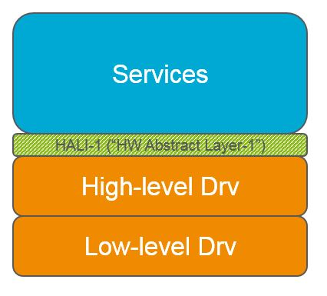
How it all started
we needed to improve HW/SW decoupling and that we should implement a HALI-1 interface. Furthermore, it was also driven by new modelized SW architect. According to the system definition, the HALI-1 interface is an interface towards low level device drivers. It would facilitate replacement of one device with a device of a similar class, e.g. replace an SPI connected ADC with another one.
The general idea was that HALI-1 would make it easier to support new radio variants.

Slide 137
Old story
Device driver interface already exist. It wasn’t a problem to support new devices. But We want to have an interface on a slightly higher level of abstraction where the objects were not devices but “resources” with a property.
Our experiences with the radio told us that the device oriented interface isn’t enough to hide common HW changes which are bigger than just the replacement of a device.

Slide 138
Level of Abstraction
Resource level
DPD
DPD
Temp
LNA
Temp
LNA
Device level
Xenon
FPGA
ADC 4 ch
ADC 4 ch
ADC 8 ch
The DPD can be in the Xenon or in an FPGA, it’s not the chip we want to publish, it’s the DPD block.
Two 4-channel ADCs can be replaced with one 8-channel ADC. It’s the channels (I/Os) that are common between designs, not the number of devices.

Slide 139
The Driver Interface aka HALI-1
Eventually there was a consensus where the higher abstraction level of our driver interface, and the focus on resources rather than devices, was chosen as the way forward.
Given that these resources are common in many radio designs, they will facilitate development of new radio variants.
New driver interface (aka HALI-1) on top of our old developed as part of the RU SW modularization.

Slide 140
Design advantages
Easy to use for SW designers
Small, simple interfaces
Type safety
Object based
Designed for testability
Unit test framework with mock objects
Small testable objects, no inheritance
Command line access to all resources
Designed for scalability
Easily scalable to more Rx/Tx branches
A branch is never explicitly specified in the driver interface
New interface can be added on for every new RU without legacy impact.

Slide 141
Interface Objects
Two different categories: Resources and Blocks
Resources represent components, analog and digital I/O.
Blocks are more complex and usually reflect functional modules.
X
X
Resource
Block

Slide 142
Blocks
A block is a collection of registers, a bit pattern, that can exist as one or many instances and in any ASIC or FPGA.
There is a 1-to-1 mapping between HW blocks and SW blocks (scaling is normally per branch).
A new HW implementation could still require a new block driver implementation even though the block interface remains the same.
The code is found in radiosw/app/drv/hali1/if/blockinterface

Slide 143
Blocks
The purpose of a block interface is to hide the location of the HW block and details like field widths and bit order.
New functionality in a HW block means that it will be treated as a new block with no relation to previous versions other than possibly the name.

Slide 144
Blocks Cont.
Radio 1
Radio 2
Radio 3
Service:A
Service:B
Service:A
Service:B
Service:A*
Service:B*
Driver Interface Layer
MyBlockV2
MyBlockV2
MyBlock
MyBlock
MyBlock
MyBlock
on() off() status() measure() compensate()
on() off() status() measure() compensate()
on() off() status()
on() off() status()
on() off() status()
on() off() status()
Driver Layer &
HW
Warp
Xenon
FPGA 1
FPGA 2
0xA1000
ON
0x120
ON
My_Block_2
0xA1004
OFF
My_Block
0x124
OFF
New revision
0xA1008
F_MEAS
0x128
STAT
0xA100B
F_COMP
0xA1010
STAT

Slide 145
Legacy Blocks
The legacy Block Interfaces are a union of all the functions of all the versions of the block. The block implementations are forced to implement a lot of empty methods that do not apply to the specific HW.
The long-term goal for the blocks is that they will be smaller, more specific and hence more stable for any given HW block.

Slide 146
Blocks – One Large interface
(Legacy Radio SW approach)
Service 1
Service 1
Service 1
f1()
f1()
f1()
Driver interface
f2()
f2()
f2()
f3()
f3()
f3()
f4()
f4()
f4()
Impact on legacy implementation and interface
Driver 1
Driver 2
Driver 3
The interface for HW 1 and HW 3 have no similarities but the legacy remains...
HW interface
1
2
3
2
4
4
HW 1
HW 2
HW 3

Slide 147
Blocks – Small Interfaces
No impact on legacy when adding support for new HW.
Service 1
Service 2
Service 3
The intent is not to hide functional changes from the services!
f1()
v1
v2
v3
Driver interface
f2()
f2()
f3()
f4()
f4()
Small interfaces that are stable once created.
Driver 1
Driver 2
Driver 3
HW interface
1
2
3
2
4
4
HW 1
HW 2
HW 3

Slide 148
Code: Service case1 (resource)
class PowerConsumptionMeas
{
Driver::VoltageSensor* pVolt;
Driver::InstanceToken m_instanceToken;……
……
……
public:
PowerConsumptionMeas (Driver::InstanceToken in) : m_ instanceToken(in), pVolt(NULL) {};
……
……
bool PowerConsumptionMeas::postInitializeService()
{
if (DataBase::autoGet("/DCVoltageSensor", voltageChName) == false)) {TRACE_ERROR (…); return false;}
RuError err;
pVolt = new Driver::VoltageSensor(err, voltageChName.c_str(), m_instanceToken);
if (err)
{
TRACE_ERROR(err.getError().c_str());
or INFO(STR("ABN:%s, %s", __func__, err.getError().c_str()));
}
return true;
}
……
……
bool PowerConsumptionMeas::sample()
{
Voltage v = pVolt->read(VruErr);
}

Slide 149
Code: Service case2 (resource)
class AntVCCService
{
Driver::VoltageSensor* m_voltageMeas;
Driver::InstanceToken m_instanceToken;
const std::string voltageSensorName("Antenna");
……
……
public:
AntVCCService(Driver::InstanceToken in) : m_ instanceToken(in), m_voltageMeas(NULL) {};
……
……
bool AntVCCService::postInitializeService()
{
RuError err;
m_voltageMeas = new Driver::VoltageSensor(err, voltageSensorName, m_instanceToken);
if (err)
{
TRACE_ERROR(err.getError().c_str());
}
return !err;
}
……
……
bool AntVCCService::measure(RuError &err)
{
m_voltage = m_simulationOn ? m_simulatedVoltage : m_voltageMeas->read(err);
}

Slide 150
Code: Service case 3 (block)
class Pa0Srv7
{
Driver::BlockInterface::Pa0V2* m_pa0Driver;
……
……
public:
Pa0Srv7 (Driver::InstanceToken in) : m_pa0Driver(BlockInterface::pa0V2(err, in)) {};
……
……
bool Pa0Srv7::setAdjust(uint8_t fbId, uint32_t pa0AdjLevel) {
RuError err;
m_pa0Driver->safeSetAdjust(ruErr, fbId, pa0AdjLevel, m_PowerRampVal);
if (err)
{
TRACE_ERROR(err.getError().c_str());
}
return !err;
}
……
……

Slide 151
wOw BETWEEN app sw AND board
Include board team!(aka the driver team in global track)
Whenever there are any changes regard to drv layter IF or impl, please present new design choices to board, site together to design a good SW for the future.
Always Invite them to code reviews when new IF impls are created.
Always Invite them to code reviews when new IF are created.
Good documentation (Mainly in doxyen)
Be aware of the SW impact and select the cheapest/best solution when given multiple choices.

Slide 152
TR report
https://lmr-radiosw-mantis.rnd.ki.sw.ericsson.se/mantis/

Slide 153
Tx Module

Slide 154
TX Module Overview
O&M Layer
TR DCI
Resource Layer
Carrier Resource Handler
I/F Objects implemented through R-LRCI
TX Branch Control
Logical Resource Objects
Service Control Layer
Service + Driver Layer
Services + Drivers
DL Subband
TDD SwitchCtrl
DL Data
MPL
DL Filter
DL FreqHop
TX Carrier Power
TRXCtrl
TXAttCtrl
PA
Power Class
CSC
DL Timing
DL Eq
CFR
TX Freq Conf
TxBranch
TXCarrier
Up Conv
Data1
DAC
Filter Branch
G
G
PA
Band Filter
f₁
DAC
Peak
Circulator
CPRI I/F
Filter Branch
G
G
f₀
f₂
Clipping
G
DPD
TX LO
Filter Branch
G
G
Data2
f₃
DAC
PA
Filter Branch
G
G
DAC
Main
f₄
DGB
DAC
DAC
ADC
TOR
Notes:
For simplicity reasons, the Service and Driver layers are combined into one layer compared with previous picture.

Slide 155
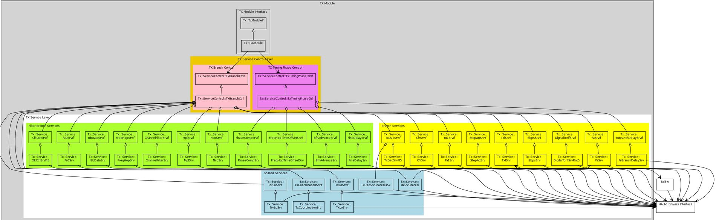
TX

Slide 156
CLASS DIAGRAM – TX FILTER BRANCH SERVICES
../sw/app/tx/serviceControl
../sw/app/tx/service
../sw/app/drv/hali1
../sw/app/drv/hali1/blockInterface
../sw/app/drv/blockInterface

Slide 157
CLASS DIAGRAM – TX BRANCH SERVICES
../sw/app/tx/serviceControl
../sw/app/tx/service
../sw/app/drv/hali1
../sw/app/service/txlSrv/If
../sw/app/service/txlSrv/TxlProxy
../sw/app/drv/hali1/blockInterface
../sw/app/drv/blockInterface

Slide 158
CLASS DIAGRAM – SHARED TX SERVICES
../sw/app/tx/serviceControl
../sw/app/tx/service
../sw/app/drv/hali1
../sw/app/drv/hali1/blockInterface
../sw/app/drv/blockInterface

Slide 159
TX MODULE SW RESOURCES
A carrier is modeled as a Filter Branch Set in Tx Module
Filter Branch Set is a list of Filter Branches with its associated carrier configuration data.
Filter Branch id range used within Tx Module is 0..7.
Hali-1 driver interfaces use filter branch id range 0..7 as input
Port swapping for PL5 occurs at Driver layer
Legacy filter branch id conversion from 0..15 to 0..7 per Tx Branch is done by Tx Adapter
Carrier id and carrier type id are not used within Tx Module
When a carrier is setup the configuration information is stored in a record and a unique FBS id is assigned to it
Carrier id is stored in the associated FBS record for later use as a reference for sending messages back to Carrier Control eg. Activation Indication
When a carrier is released the associated FBS record is removed.

Slide 160
TX MODULE HW RESOURCES
HW resources are configured and managed by Services
HW configuration topology is transparent to the Tx Branch Controller
The status and configuration of HW resources are not retained by Services – once the HW change occurs, the Service forgets its configuration
The status and configuration of such HW resources as TxLo, TorLo and Pa is stored in and maintained by the Resource Handler and can be accessed by all Services by means of well defined interfaces

Slide 161
TX BRANCH CONTROL
SW location: ../app/sw/tx/serviceControl
Active Object
controller for actions on each Tx Branch.
platform and hardware independent
state machine driven
controls all transmit carriers (FBSs). This includes requests for setup, activate, deactivate, release, frequency modify and power modify.
for all carrier operations it triggers all the required steps on TX services.
the dependency between steps or the service dependencies is embedded in the steps that TxBranchCtrl follows.
does not perform validation of carrier configuration coming from Carrier Control

Slide 162
Downlink frequency
26/102 62-CNH 160 6510
Purpose
Configures NCO, TX_LO, TOR_LO to achieve wanted RF frequency.
Description
TX LO frequency: Center frequency of the used DL bandwidth.
NCO frequencies: Offset frequency for each carrier vs. TX LO.
TOR LO frequency: Down converting frequency for the DPD loop. Set to fixed offset to TX LO.

Slide 163
DL Filter
27/102 62-CNH 160 6510
Purpose
Achieve signal RRC (Root Raised Cosine)shaping thus reduce ISI
Description
Select/Configure corresponding coefficients for different carrier types: GSM (200kHz), WCDMA (3.8-5MHz) and LTE (1.4, 2.5, 3, 5, 10, 15, 20MHz).

Slide 164
DL time alignment
38/10262-CNH 160 6510
Purpose
Adjust/align total delay from node reference point (T_RP) to Antenna Reference Point (ARP) in radio so that the carrier user data reaches the antenna at a given BFN time.
Description
Total delay is the sum of (1) CLK delay from T_RP to the RRU, (2) CLK delay within COM-FPGA, (3)RRU internal digital/analog delay and (4) external delay from RRU to ARP.
The compensation is done in the ASIC.

Slide 165
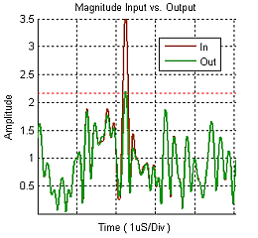
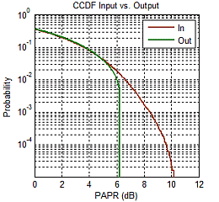
Crest Factor Reduction
25/102 62-CNH 160 6510
Purpose
PA capacity shall cover Pnom+PAR@0.1% probility
Lower PAR → lower cost and higher efficiency
Description
MPLC: Mean Power Loss Compensation compensates for the small reduction of power introduced by the clipping

Slide 166
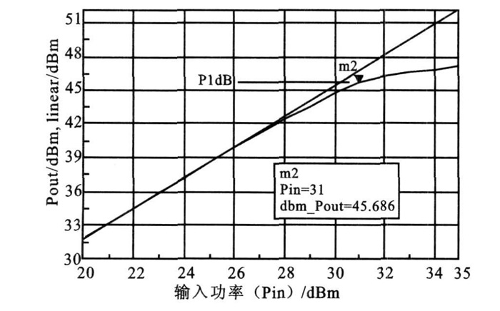
TRX control
49/102 62-CNH 160 6510
Purpose
Runtime conpensate compression characteristic of PA HW
Conpensation gain changes caused by temperature/frequency
PA compression curve

Slide 167
DL Power/Gain Compensation
58/102 62-CNH 160 6510
Description
DL Pcomp controls output power setting and gain compensation in DL.
PA0 sets correct nominal output power per carrier/fb for G/W/L
PA0 also compensates (Front End filter) output power per carrier within IBW (20MHz) for W&L and static GSM.
PA1 sets correct DPD input power for G/W/L.

Slide 168
Power Amplifier Control and Supervision
24/102 62-CNH 160 6510
Purpose
Set to best bias voltages depending of power class
Control PA on/off for TDD or power saving

Slide 169
DS
DS 25/102 62-CNH 160 6510 Crest Factor Reduction
DS 20/102 62-CNH 160 6510 DL Data
DS 44/102 62-CNH 160 6510 DL Equalizer
DS 27/102 62-CNH 160 6510 DL Filter
DS 77/102 62-CNH 160 6510 DLPerfCtrl
DS 38/102 62-CNH 160 6510 DL Time Alignment for RU
DS 29/102 62-CNH 160 6510 DL Subband
DS 4/102 62-ROP 101 089/1 DL Mixer, NCO and Carrier Combiner
DS 28/102 62-CNH 160 6510 MPL
DS 49/102 62-CNH 160 6510 TRX Control
DS 88/102 62-CNH 160 6510 TX Analog Gain and Attenuation Control
DS 81/102 62-CNH 160 6510 TX Branch Control
DS 58/102 62-CNH 160 6510 TX Carrier Power
DS 26/102 62-CNH 160 6510 TX Frequency Configuration
DS 85/102 62-CNH 160 6510 TX Main
DS 102 62-CNH 160 6510 TX Module Startup and Initialization
DS 24/102 62-CNH 160 6510 TX PA Control and Supervision
DS 46/102 62-CNH 160 6510 TX Power Class

Slide 170
Filter Branch Services
The notion of Filter branch services pertains to services which are responsible for configuration of digital filter branches on the digital ASIC (e.g. WARP, iWARP, Xenon) HW blocks.
The Tx Module supports such filter branch services as MplSrv, FreqHopSrv, and Pa0Srv just to mention few.
Filter branch services configure filter branches only and have no notion of Filter Branch Sets (FBS) or carriers.

Slide 171

Digital asic – filter branch
Each filter branch does the digital signal processing for one carrier (of certain bandwidth):
GSM, WCDMA, LTE (FDD or TDD), CDMA
Description of Parameter | WARP 1.7 | WARP 3.0 | WARP 3.5 | iWARP 3.5 | Xenon1.0
Total number of filter branches in one ASIC | 4 | 16 | 16 | 16 | 24
Number of ≤ 5MHz Filter Branches | 4 | 8 | 0 | 0 | 0
Number of Narrowband Filter Branches (GSM) | 0 | 8 | 0 | 0 | 0
Number of ≤ 10MHz Filter Branches | 0 | 0 | 16 | 16 | 0
Number of ≤ 20MHz Filter Branches | 0 | 0 | 0 | 0 | 24
Supports Fullband LTE carriers (10, 15, 20 MHz) | no | yes | yes | yes | yes

Slide 172
TX BRANCH SERVICE
The notion of Branch services pertains to Tx branch services which are responsible for the configuration of analog and digital HW components belonging to a particular RF Tx branch.
Branch services use Filter Branch Sets (FBS) in the algorithmic calculations.
The Tx Module supports such branch services as PaSrv, Pa1Srv, and TxlSrv to mention few.
Branch services configure analog parts such as PA and step attenuator as well as such HW blocks on the digital ASIC as CFR and PA1.

Slide 173
TX Service topology
The Tx Module supports the following service types:
Filter Branch Services – services which configure the digital ASIC HW blocks with digital filer branches. An example of such service is the Pa0Srv.
RF Branch Services – services which configure HW components specific to a particular TX branch. An example of such service is the cfrSrv.
Shared services – services which are common to multiple TX branches. An example of such service is the TxLoSrv. Shared services typically manage HW components that are common to multiple TX branches.

Slide 174
Tx shared service
The notion of Shared services pertains to Tx Branch services shared between multiple instances of Tx Module (Tx Branch Controllers).
The Tx Module supports such shared services as TxLoSrv, TorLoSrv, PaSrv and TxCoordinationSrv.
The TxCoordinationSrv coordinates functional cycles between set of branches sharing common HW to ensure no deadlocks.
With the exception of the TxCoordinationSrv, a shared service manages a HW component that is common to multiple TX branches (TxCoordinationSrv is a special service that is not directly mapped to any particular hardware component).

Slide 175
Tx shared service
Multiple Tx Branch Controllers subscribe to shared service events at radio start-up time.
Shared services use data from each subscribing Tx Branch Controller (Resource Handler).
Controllers pass the reference to their Resource Handler to shared services at service initialization time.
Shared services operate via broadcasting of events to the subscribing controllers
Multiple Tx Branch Controllers subscribe to shared service events at radio start-up time.

Slide 176

Shared services – TX Example

Slide 177


Slide 178

Subband Backgroud
Originally created for RU platform 4 to enable 10, 15 and 20MHz LTE (FDD or TDD) carriers by combining multiple 5MHz Subbands.

Slide 179
Temperature Compensation
Adjust drain voltage PA_Vdd to optimize PA efficiency.
Set a optimal digital word into the DAC that controls the drain voltage.
Started upon PA On, takes place periodically until PA Off.
Each PA_Vdd voltage is temperature compensated separately if more than one TX branch.

Slide 180

DAC towards Temperature

Slide 181

Sequence Diagram

Slide 182
Frequency Compensation
In some frequency bands there is a need to increase the drain voltage on the band edges.
If no freqCompTable in pa_production_db, temperature compensation only.
Started upon PA On together with temperature compensation, takes place periodically until PA Off.

Slide 183
ACTIVE OBJECT / CURRENT OSE PROCESS PRIORITIES
An Active Object is an object that owns an OSE process and can initiate control activity.
0 is OSE highest priority, 31 is OSE lowest priority
trProc and trDcProc (Carrier Control) – OSE priority 15
no change to current setting
TxBranchCtrlA/B, PaSrvA/B, TxLoSrv, TorLoSrv – OSE priority 14
ensures that LPLC/SPLC frequency and power change operations will get to run before majority of processes including Carrier Control
RICR_sup_link_1/0 and RICR_fault_handler run at this priority
TxCoordinationSrv (Cycle Coordinator) – OSE priority 16
will delay cycle start until Carrier Control completes processing of all carrier requests (Rx and Tx) buffered in the OSE queue
maximizes buffering of Tx carrier events
TxlProcBranchA/B – OSE Priority 10

Slide 184
REFERENCE
TX DD (alive and heavy, but good detail info…)
https://erilink.ericsson.se/eridoc/erl/objectId/09004cff88b5b867?docno=4/15961-CNH1606510Uen&action=current&format=msw12
Doxygen documentation
https://fem007-eiffel003.rnd.ki.sw.ericsson.se:8443/jenkins/view/RadioSW/view/Doxygen/job/radio_doxygen_radiosw/doxygen/
RA Radio/Product Documents wiki page
https://lte-wiki.rnd.ki.sw.ericsson.se/mediawiki/index.php/RA_Radio/Product_Documents

Slide 185
CARRIER EVENT PROCESSING

Slide 186
TX ADAPTER
SW location: ../sw/app/adapter/tx
Subscribes to carrier control events on behalf of TxBranch controller (see next slide)
Converts legacy carrier data structure to tx data structure when carrier event is sent to Tx Module
performs SW database lookups for carrier type based keys (signal BW, power compensation, bb scaling etc)
Design Rule: carrier type should not be used within Tx Module
converts legacy filter branch id to filter branch id range 0..7
Provides API for 0-insertion via by CSC
Provides API for sending Activation Indication/Power Modify Indication from Tx Module to Carrier Control

Slide 187
TXADAPTER - CARRIER EVENT SUBSCRIPTION
TxBranchCtrl subscribes to carrier events via the TxAdapter with the CR_SUBSCRIPTION_PRIORITY_SETUP_CARRIER_DIG priority.
enum CarrierSubscriberPriority_t
{ CR_SUBSCRIPTION_PRIORITY_HIGHEST = 1,
CR_SUBSCRIPTION_PRIORITY_CONFIG_DATA_STREAM_DIG = CR_SUBSCRIPTION_PRIORITY_HIGHEST,
CR_SUBSCRIPTION_PRIORITY_TDD_SWITCH_CTRL = CR_SUBSCRIPTION_PRIORITY_HIGHEST + 1,
CR_SUBSCRIPTION_PRIORITY_SETUP_CARRIER_DIG = CR_SUBSCRIPTION_PRIORITY_HIGHEST + 2, TxBranchCtrl Subscriber Priority
CR_SUBSCRIPTION_PRIORITY_SETUP_POWER_COMP = CR_SUBSCRIPTION_PRIORITY_HIGHEST
CR_SUBSCRIPTION_PRIORITY_TIME_ALIGN_SETTINGS = CR_SUBSCRIPTION_PRIORITY_HIGHEST + 4,
CR_SUBSCRIPTION_PRIORITY_NCO_SETTINGS = CR_SUBSCRIPTION_PRIORITY_HIGHEST + 5,
CR_SUBSCRIPTION_PRIORITY_FREQHOP_SETTINGS = CR_SUBSCRIPTION_PRIORITY_HIGHEST + 6,
CR_SUBSCRIPTION_PRIORITY_FILTER_SETTINGS = CR_SUBSCRIPTION_PRIORITY_HIGHEST + 7,
CR_SUBSCRIPTION_PRIORITY_PHASE_ALIGN_SETTINGS = CR_SUBSCRIPTION_PRIORITY_HIGHEST + 8,
CR_SUBSCRIPTION_PRIORITY_LOWEST = CR_SUBSCRIPTION_PRIORITY_HIGHEST + 9
};
TxBranchCtrl subscribes to the following carrier events via the TxAdapter:
CR_SUBSCRIPTION_EVENT_CARRIER_RELEASED
CR_SUBSCRIPTION_EVENT_CARRIER_SETUP
CR_SUBSCRIPTION_EVENT_CARRIER_ENABLED
CR_SUBSCRIPTION_EVENT_CARRIER_DISABLED
CR_SUBSCRIPTION_EVENT_CARRIER_MODIFY
CR_SUBSCRIPTION_EVENT_CARRIER_POWER_MODIFY

Slide 188
EVENT PROCESSING - CYCLE FLOW
Cycle is a sequence of operations required for one TxLo change and one power change on one or two tx Branches
Two cycles:
Power Change Cycle
Frequency Change Cycle

Slide 189
EVENT PROCESSING
Services process data derived from multiple carrier events which arrived prior to the cycle start
Carrier events may arrive during a cycle while services are in the process of frequency change or power change
In order to avoid collisions of the new arriving carrier event data with the carrier event data services are currently processing, two sets of carrier data exist:
set of data committed to the currently running cycle: this data is locked in - it is not updated throughout the cycle
set of buffered data: this data is updated as new carrier events are arriving during the cycle
At the beginning of each cycle, the buffered data is moved to the committed data.

Slide 190
EVENT PROCESSING - DATA FLOW DURING CYCLE

Slide 191
DATA FLOW DURING CYCLE
At the beginning of each Freq change cycle Buffered data is transferred to Committed data.
At the end of each Power change cycle, Buffered data is evaluated for new cycle trigger.
If new cycle required:
send trigger to Tx Coordination service.
while waiting for Tx Coordination service for response, Tx BranchCtrl keeps updating the Buffered data when new events are coming.
once the Tx Coordination service trigger to start Freq change cycle arrives, commit the Buffered data i.e. compare and evaluate the current Buffered data and the Committed data used in the previous cycle.
Both Buffered and Committed Data sets are the same at the beginning of each Freq change cycle.
proceed with the cycle
If no new cycle required:
update the Buffered data as new events are incoming
re-evaluate for new cycle
If cycle trigger comes due to another branch request:
commit the Buffered data

Slide 192
EVENT PROCESSING – RESOURCE HANDLER
Resource Handler is the owner of the Buffered and Committed data and operations on it.
Resource Handler is responsible for:
allocation/deallocation of resources
resource state and configuration updates
Tx Branch Control triggers operations on RH to update the Buffered data based on event received from Carrier Control.
Tx Branch Control is responsible for the Commit operation i.e. based on Buffered and Committed data from the last cycle. Tx Branch Control figures out new Committed data contents. Resource Handler updates the Committed data.
Tx Branch Control owns the algorithm for committing data. RH owns the contents of the data.

Slide 193
TXCOORDINATIONSRV
Active Object
SW Location: ../sw/app/tx/services/txCoordinationSrv
Coordinates frequency and power change cycle(s) for all Tx Branch controllers
State machine controlled
Ensures the correct ordering of frequency and power changes by an API that the TxBranchCtrl registers with.
The service control layer requests the cycle when a carrier request requires one. When the state of Tx Coordination is ready it will begin the cycle.
If there is a cycle underway it will be blocked pending the completion of the current cycle.
To start a cycle Tx Coordination sends notifications through the API to do frequency changes.
This is the trigger for the service control layer to do the actual frequency change steps by controlling the required services. E.g. txLo, torLo or ncoSrv.
Tx Coordination is not aware of which services are used or their order. Once the service controller completed the frequency change it will notify Tx Coordination that it is done.
Only at this point will Tx Coordination trigger the power change by using its API to signal to the service control layer to start a power change cycle. This proceeds in the same way as a frequency change.
The control layer works with the services to do any power changes and then signals Tx Coordination that it is finished the power change cycle.

Slide 194
What is changed and unchanged (FOR FSM imported into Tx module)
We moved code from a big class to some small classes.
The change cycle FSM is added
Two helper classes are added for the FSM.
Add two helper class for POWER_CHANGE state. One for LPLC and the other for SPLC.
No any function change is expected in the resturcturing.
The restructuring does not change any external behavior of TxBranchCtrl.
For all sequence diagrams in “TX Module DD”, TxBranchCtrl is still original TxBranchCtrl, the resturcturing has no DD impact.

Slide 195

Tx Branch Ctrl and its helpers
Notes:
Notes:
TxChangeCycleFsm is the FSM class, which provides two interface: TxChangeCycleFsmIf and TxChangeCycleFsmInternalIf.
TxChangeCycleFsmIf is to be used by TxBranchCtrl.
TxChangeCycleFsmInternalIf is to be used by all change cycle states.
All change cycle states have a base class TxChangeCycleState.
A TxChangeCycleFsm instance owns below instances:
The instances of all change cycle states. They’re used by a pointer of their base class, i.e. TxChangeCycleState.
An instance of TxChangeCycleBasicHelper.
An instance of TxChangeCycleHelper.
A TxChangeCycleFsm instance passes “this” pointer of type TxChangeCycleFsmInternalIf to instances of all change cycle states.
A TxChangeCycleFsm instance may pass instance pointers of either TxChangeCycleBasicHelper or TxChangeCycleHelper to the instance of any change cycle state if necessary.
A TxChangeCycleFsm instance passes instance pointers of TxChangeCycleBasicHelper to instance of TxChangeCycleHelper.

Slide 196
Change cycle states
Change cycle states:
enum TxBranchCtrlTxChangeCycleStateEnumType
{
TX_BRANCH_CTRL_TX_CHANGE_CYCLE_STATE_IDLE,
TX_BRANCH_CTRL_TX_CHANGE_CYCLE_STATE_INIT,
TX_BRANCH_CTRL_TX_CHANGE_CYCLE_STATE_PREPARATION,
TX_BRANCH_CTRL_TX_CHANGE_CYCLE_STATE_TX_LO_CHANGE,
TX_BRANCH_CTRL_TX_CHANGE_CYCLE_STATE_POWER_CHANGE,
TX_BRANCH_CTRL_TX_CHANGE_CYCLE_STATE_FILTER_BRANCH_FINALIZATION,
TX_BRANCH_CTRL_TX_CHANGE_CYCLE_STATE_TXL_FINALIZATION,
TX_BRANCH_CTRL_TX_CHANGE_CYCLE_STATE_TXL_RESTART_FINALIZATION,
TX_BRANCH_CTRL_TX_CHANGE_CYCLE_STATE_FINALIZATION // add it as per input
};
We found state transitions by searching “setTxChangeCycleState” in base code.
We named events based on function names where the state transitions happen.

Slide 197

The FSM

Slide 198
Behavior change
There is a subtle behavior change:
Before the restructuring, we set To-state of change cycle no matter what is the From-state, e.g.
setTxChangeCycleState(TX_BRANCH_CTRL_TX_CHANGE_CYCLE_STATE_PREPARATION);
After the restructuring, the From-state and To-state of all state transitions are explicitly defined.
We have checked that all reasonable state transitions are implemented.
But if an event is received in an unexpected state, the behavior is different between old and new implementation.

Slide 199
Set state
bool TxChangeCycleFsm::setState(TxChangeCycleState *newState, bool *pResult)
{
bool rollback, result;
TxChangeCycleState *oldState;
m_state->onExit();
oldState = m_state;
m_state = newState;
TRACE_OBJ(1, BRC_TX, STR("Change cycle state from %s to %s", oldState->getState().toString().c_str(), newState->getState().toString().c_str()));
result = m_state->onEnter(rollback);
if (pResult)
{
*pResult = result;
}
if (rollback)
{
m_state = oldState;
TRACE_ERROR(STR("Fail in onEnter of %s, rollback to %s", newState->getState().toString().c_str(), oldState->getState().toString().c_str()));
return false;
}
return true;
}
Search “m_fsm->setState” to find all state transitions now.
onExit is called when we exit a state.
onEnter is called when we enter a state.
“rollback” is added to keep legacy behavior.
In TxBranchCtrl::changeFinalize of old code, change cycle state is not changed if the function needs to return false. So previous state is kept.
The code of TxBranchCtrl::changeFinalize is moved to TxChangeCycleStateFinalize::onEnter of new code. We need to rollback to previous state when TxBranchCtrl::changeFinalize return false.
Some onEnter() may return false but it does not need rollback. So a new out parameter is added to onEnter.

Slide 200
Design suggestions
Putting functions into change cycle states is more preferred compared to put them into FSM or helpers.
Stateless functions (i.e. functions which have no relation with change cycle states) should be put into helpers if possible.
Helpers of FSM (e.g. TxChangeCycleBasicHelper, TxChangeCycleHelper or new helpers) should depend on different services if possible.
New helper should be created if there is a group of new functions with strong cohesion is needed in the FSM.

Slide 201

Input
“TX Branch Control Restructuring A1.pptx”
Reason of change
The class of TxBranchCtrl is too big. (~8000 lines, 265 member functions and 80 private members)
Change cycle states are checked on a “need” basis via if statements. State pattern is wanted to improve code structure.

Slide 202
RESOURCE HANDLER
SW location: ../app/sw/tx/serviceControl/resourceHandler
There is one instance of Resource Handler per Tx Module
Passive object
Modeled as a shared database that can be accessed by all services/service controllers in the Tx Module.
RH is a repository of the following information:
FBS configuration and state data
current HW configuration and state data for TxLo Freq, Power Level, TorLo
All services have access to this information.
Only Tx Branch Control can update this data

Slide 203
RESOURCE HANDLER (CONTINUED)
Allocates resources upon requests from TxBranchCtrl (due to Set-up Requests).
Cleans up resources upon requests from TxBranchCtrl (due to Release Requests)
All services (except the TxCoordinationService) have access to RH via means of reference passed to them during initialization when dependencies are created

Slide 204
RESOURCE HANDLER

Slide 205
FBS DATA RECORD
Resource Handler stores the following configuration data for each FBS/FB:
Filter Branch list
Frequency data:
frequency
arfcn data
Power data:
carrier Power
reserved Power
Bandwidth data
signal BW related
Common data (per each entry):
FBS Id or FB Id
state
RAT type
carrier id (needed for FreqHop)
Frequency configuration change status: changed/unchanged
Power configuration change status: changed/unchanged
State change status: changed/unchanged

Slide 206
FBS/FB STATE TRANSITIONS
carrier power modify event
carrier
released
event
carrier frequency modify event
unallocated
carrier
setup
event
setup
carrier
enabled
event
enabled
carrier
released
event
releasing
carrier
enabled
event
carrier
disabled
event
carrier
released
event
disabled
carrier power modify event
carrier frequency modify event
Similar to current carrier states and their transitions
FBS state is updated according to the event received as per the state transition diagram above
Filter Branch (FB) inherits its state from its parent FBS

Slide 207
FBS/FB STATES
unallocated – empty FBS record
setup – FBS resources and a unique FBS id was allocated due to a received carrier setup event
enabled – FBS has baseband traffic flowing
disabled – FBS is configured but baseband traffic is blocked (0-insertion is applied)
releasing - FBS is in the process of releasing; baseband traffic is blocked (0-insertion is applied)

Slide 208
DATA RETRIEVAL FROM RESOURCE HANDLER
Data “pull” model is used
Services retrieve relevant FBS/FB or HW configuration data from Resource Handler on demand
TxBranchCtrl does not push data to Services (unless there is a scenario where it is absolutely needed)
Resource Handler provides a set of well defined interfaces for Services to access relevant data:
Per Filter Branch Set data – returns vector of Freq/Power/BW data + Common data per Filter Branch Set
getFrequencyData_allFBS()
getPowerData_allFBS()
getBandwidthData_allFBS()
…
Per Filter Branch data - returns vector of Freq/Power/BW data + Common data per Filter Branch
getFrequencyData_allFB()
getPowerData_allFB()
getBandwidthData_allFB()
…
Notes:
_allFB means all configured Filter Branches
_allFBS means all configured Filter Branch Sets

Slide 209
RESOURCE HANDLER – FBS CONFIGURATION
FBS configuration resides in two almost identical data bases in the Resource Handler:
Committed Data DB
Buffered Data DB
Committed Data contains FBS configuration records committed to the currently running cycle of frequency and power change.
Once the frequency change and power change cycle starts this data is locked- it is not updated throughout the cycle
Buffered Data contains FBS configuration records which are updated as new carrier events are arriving during the frequency and power change cycle

Slide 210
FILTER BRANCH
FB state inherited from FBS
FCC : Frequency Configuration Change status
PCC : Power Configuration Change status
ZIns : Zero insertion flag (not covered in the rest of this discussion)
Enum values for FCC and PCC
U: Unchanged
C: Changed

Slide 211
BUFFERED DATA UPDATE
TxBranchCtrl updates the Buffered data each time a carrier event arrives (set-up req, activate req, deactivate req, release req, freq modify req, power modify req)
Information updated in the Buffered data is per Filter Branch Set (a.k.a. carrier)
The following information is updated:
final state of the FBS at the end of the cycle for which this Buffered entry will be committed
Cycle Request pending flag
configuration data if required

Slide 212
CYCLE TRIGGERS
No cycle is not triggered for the following events:
FBS is disabled and Frequency Modify req received
FBS is disabled and Power Modify req is received
FBS is unallocated and Set-up req received
Cycle is triggered any if of the following occurs:
Activate req received for any FBS
Deactivate req received for any FBS
Release req received for existing ¹ FBS
FBS is enabled and Frequency Modify req is received
FBS is enabled and Power Modify req is received
TxBranchCtrl determines if cycle needs to be triggered at the end of the current cycle
Steps:
For each carrier in the Buffered Data
if Cycle Needed == TRUE
request cycle from TCS
exit iteration
¹ If FBS is already in Committed data then it is called “existing”. For FBS which are “Newly created” in the Buffered data and a Release Req is received, no cycle is required – the FBS is just cleaned-up and the state is set to Unallocated.

Slide 213
COMMITTED DATA UPDATE
At the beginning of each cycle, TxBranchCtrl determines the changes to the Committed data.
TxBranchCtrl compares the Committed data and Buffered data from the previous cycle and determines the new set of Committed data.
RH is asked to store the new Committed data.
Common working data from the previous cycle (TxLo Freq, Power Level, TorLo, etc) is carried on to the next cycle.

Slide 214
COMMIT
Commit observes the following steps:
Remove all FBS that are in Releasing state in the Committed data
Calculate Filter Branch configuration change status based on FBS state in Committed and Buffered data
Update Committed Configuration Data (this is expected to be a simple copy of the pre-processed buffered configuration data).
Reset the “newly created” flag for all FBS moving to Committed Data

Slide 215
SPLC

Slide 216
Questions / feedbacks
Now, I hope you are not afraid to have a look at the picture below ☺ ☺ ☺
From the most important DS for SPLC, TX Branch Control

Slide 217
Power Level Change Introduction
This is introduction material with main focus on Radio Functions at Power Level Change which is the most complicated part of WP1186.
This material aims to help the reading/understanding of related DS:es and WP1186 implementation.
This material is NOT any kind of formal desigen specification.
It does NOT necessarily to be aligned exactly with DS:es or SW implementation since they keep on changing.
Expectation after this Presentation: SPLC(Seamless Power Level Change) is not so complicated as it was believed.

Slide 218

Part 1 Radio Function View:What is PowerClass
20W
40W
PowerClass: Production calibrated PA configuration for certain power.
TxStepAtt
(Gain)
Vdd
Power
PowerClass: A better name could be PA size or Power Level
TxStepATT
Vdd
PowerClass/PowerLevel change (Legacy): from one production calibrated PA configuration to another production calibrated PA configuration.
Power
Biasing
Biasing
Power

Slide 219
Part 1 Radio Function View:DL Gain Control Complete Pictures
Blocking (Zero Insertion)
20W
40W
Why: avoid abrupt change at PA.
TxStepAtt
(Gain)
Power
Most dangerous during PLC: TxStepAtt.
Vdd
Where: before channel filter.
Power
Digital Domain
Analog Domain
Biasing
PA Block
Inside Warp
DPD Block
Power
Tor
(Gain, Total)
Power
PA0
(existing
enabled cr)
Power
TOR Block

Slide 220
Part 1 Radio Function View:LPLC (Legacy/Static Power Level Change)
Problems with LPLC:
20W
40W
Long traffic interrupt, up to 1,6 seconds
TxStepAtt
(Gain)
Traffic situations with Carriers with very low power(s) -->
High PL (Analog Gain), very low PA0 (Digital Gain)
Then RU can’t change PL very often. This introduced many complex rules with DS PowerClass.
Power
Background Noise
DPD performance !!!
Vdd
Performance problems with LPLC: DPD and Power efficiency for instance
Step 3: PA OFF,
reconfigure PA to next PL,
PA ON
Power
Digital Domain
Analog Domain
Biasing
Power saving
Power
PA Block
Tor
(Gain, Total)
Step 1: Blocking
Inside Warp
DPD Block
Power
PA0
(existing
enabled cr)
Power
Step 2: TxL::stop(), why ???
Step 4: remove blocking
Step 6: Finalizing. All function blocks which have dependency on PL:
PA0, MPL, CFR and DlPerf.
TOR Block
Step 5: TxL::start()
For new PL, it takes time !!!

Slide 221
Part 1 Radio Function View: What is SPLC (Seamless Power Level Change)
Goal for SPLC:
Many interrupts of traffic,
which is not allowed by RS
20W
40W
Shorter traffic interrupts
TxStepAtt
(Gain)
Set power level close to total setup power but with good margin for better performance
LPLC stops DPD
Power
These power levels are not necessarily a production calibrated PC
Vdd
SPLC needs to keep DPD in tuned state
How ???
Power
Digital Domain
Analog Domain
Biasing
Power
PA Block
Tor
(Gain, Total)
Inside Warp
DPD Block
Power
PA0
(existing
enabled cr)
Power
TOR Block

Slide 222
Part 1 Radio Function View: How to achieve a SPLC
Not necessarily must be a
production calibrated PL!
Spreaded calculation/decisions among services based on total adjustment and nof iterations: Preparation and Execution
20W
40W
Phase 1: TxModuleSet
Phase 1(TxModuleSet):
Step 3: change TxStepATT
And PostDpd Gain together
TxStepAtt
(Gain)
PostDpd Adjustment for example:
Preparation: Inform TxL about the adjustments caused by TxStepAtt, TxL::initSPLC(U32 nIterations, float postDpdGainDiff_dB), TxL builds up adjustment for each iterations.
Step2 execution: Order TxL to perform an adjustment for a iteration TxL::setSPLCPostDpdGain(void).
Has pre-PA gain (Warp-to-PA) changed ???
Phase 2: Scaling
What has be achived ???
Changed TxStepAtt with one shot !
time
Phase 3: Finalizing
Post DPD
Gain
Phase 1(TxModuleSet):
Step 4: TxL::pause(disable)
Resume DPD in Tuned state.
PostDpdGain adjustment affects pre-PA gain
in the same way as TxStepAtt steps
When decreasing Power
Reversed order with
Phase 1 and Phase 2.
TxL::recalibate()
Tor
(Gain, Total)
Phase 1(TxModuleSet):
Step 1: TxL::pause(enable)
Pause DPD instead of stop()
Analog Domain
time
Digital Domain
PA Block
PA0
(existing
enabled cr)
Phase 1(TxModuleSet):
Step 2: Blocking
Inside Warp
DPD Block
time
Vdd
Phase 1(TxModuleSet):
Step 5: remove blocking
Biasing
Finalizing. All function blocks which have dependency on PL:
MPL, PA0, CFR and DlPerf.
TOR Block
One iteration of scaling cycle completed !
time

Slide 223


Part 1 Radio Function View: TxLO Moving
This slide is needed to explain the whole blocking scenario
Branch A
freq
Branch B
FNCO2
freq

Slide 224
Part 1 Radio Function View: Traffic Blocking with Power Increasing
”Should be” Scenario according to current requirement
SW Impl. Frequency Cycle
SW Impl. Power Cycle
Change TxLo
Update NCO and FreqHop LUT
Change TxStepAtt
TxLo change preparation: Frequency calculation
Scaling
UP!!!
Power Level
TxL recalibration
Next Blocking
< 60 ms !!!
< 60 ms !!!
< 60 ms !!!
time
> 500 ms between blockings !!!
> 500 ms
> 500 ms
Carrier Activation
deblocking: remove zero insertion
Training Signals interrupt traffic
Blocking: Zero insertion
Blocking: Zero insertion
deblocking: remove zero insertion
Blocking: Zero insertion

Slide 225
Part 1 Radio Function View: Traffic Blocking with only TxLO moving
SW Impl. Frequency Cycle
Change TxLo
Update NCO and FreqHop LUT
TxLo change preparation: Frequency calculation
TxL recalibration
Next move of TxLo, TxStepAtt
< 60 ms !!!
< 60 ms !!!
time
> 500 ms between blockings !!!
> 500 ms
Frequency Modification
Blocking: Zero insertion
deblocking: remove zero insertion
Training Signals interrupt traffic
Blocking: Zero insertion

Slide 226
Part 2 SW View:Service Mapping
With current WP1186 implementation, the most important services are:
TxBranchCtrlSrv and PaSrv
Radio Function blocks, DS.es
SW elements

Slide 227
Part 2 SW View: Class Overview
Func
layer
Tx-Module
HALI1
Branch A
CFR
Driver
FreqHop
Driver
MPL
Driver
NCO
Driver
ResourceHandler
PA0
Driver
PA1
Driver
TXL
Driver
TxStepAttenuator
Driver
PA (Branch)
Driver
CarrierListHandler
TxBranchCtrl
TxAdapter
TxBranch
Repository
TxCoordination
TxLo
TorLo
PA (Shared VDD)
TxLo Synth
Branch B (if exists)
CarrierSubscriberIf
TxBranchCtrl
(Services)
TorLo Synth

Slide 228
Part 2 SW View:State Machines
The state machine of TxBranchCtrl

Slide 229
Part 2 SW View:State Machines
The state machine of PaSrv

Slide 230
Part 2 SW View: TxBranchCtrlSrv and PaSrv interactions
void PaSrv::notifyResultToClients( bool p_result )
{
TRACE_OBJ(9, PA, STR("notifyResultToClients, m_txBranchId=%d, p_result=%d.",
m_txBranchId, p_result ));
// Notify outstanding callback functions of the failure.
map<TxBranchEnumType, PaSrvClientRecord_t*>::iterator it;
for(it = m_paSrvClients.begin(); it != m_paSrvClients.end(); ++it)
{
switch(m_paSrvClients[(*it).first]->event)
{
case PA_SRV_EVENT_STATIC_PC_APPLY:
m_paSrvClients[(*it).first]->onStaticPowerChangePrepare.emit(p_result);
break;
case PA_SRV_EVENT_STATIC_PC_PREPARE_DONE:
m_paSrvClients[(*it).first]->onStaticPowerChangeBegin.emit(p_result);
break;
case PA_SRV_EVENT_STATIC_PC_BEGIN_DONE:
m_paSrvClients[(*it).first]->onStaticPowerChange.emit(p_result);
break;
case PA_SRV_EVENT_STATIC_PC_DONE:
m_paSrvClients[(*it).first]->onStaticPowerChangeComplete.emit(p_result);
break;
case PA_SRV_EVENT_DYNAMIC_PC_APPLY:
m_paSrvClients[(*it).first]->onDynamicPowerChangePrepare.emit(p_result);
break;
case PA_SRV_EVENT_DYNAMIC_PC_PREPARE_DONE:
m_paSrvClients[(*it).first]->onDynamicPowerChange.emit(p_result);
break;
case PA_SRV_EVENT_DYNAMIC_PC_DONE:
{
DynamicPowerStepChgResults_t results( p_result, m_currStepNum );
m_paSrvClients[(*it).first]->onDynamicPowerStepChange.emit(results);
break;
}
TxBranchCtrl
m_paSrvIf->staticPowerChangeApply(m_txBranchId))
bool TxBranchCtrl::doStaticPowerChangePrepare(void)
{
if ((m_paSrvIf->staticPowerChangePrepareDone(m_txBranchId)) == false)
return true;
}

Slide 231
Part 2 SW View:Analysis of traces
/// from 0W ---> 40W
[1970-01-01 00:01:22.772] PaSrvA paSrvBranch.cc:354 TRACE2:PaSrvA doPowerLevelCalculation, branch=0 isPwrChgRequired=1 powerChgMode=0 currPLDbm=0 curPLWatt=0W, targetPLDbm=4600 targetPLWatt=40W numSteps=1
[1970-01-01 00:01:22.772] PaSrvA txBranchCtrl.cc:2223 TRACE1:onCalculateIsPowerChangeRequiredResponse: branch:0
[1970-01-01 00:01:22.772] TxBranchCtrlA txBranchCtrl.cc:2236 INFO:doCalculateIsPowerChangeRequiredResponse: returnStatus: 0, isPwrChgReq: 1, powerChgMode: 0, currentPowerLevel: 0, targetPowerLevel: 4600, numSteps: 1
/// @ PaSrv: PA_SRV_EVENT_STATIC_PC_APPLY
[1970-01-01 00:01:22.776] TxBranchCtrlA paSrv.cc:418 TRACE9:PaSrvA staticPowerChangeApply, p_branchId=0
[1970-01-01 00:01:22.776] PaSrvA paSrv.cc:1065 TRACE9:doPowerChangePrepare, client=0 m_paSrvState=0 event=2
[1970-01-01 00:01:22.776] PaSrvA paSrv.cc:835 TRACE9:validateEventAndClient, p_clientId=0 p_event=2 m_paSrvState=0
[1970-01-01 00:01:22.776] PaSrvA paSrv.cc:1807 TRACE9:notifyResultToClients, m_txBranchId=0, p_result=1.
// @ TxBranchCtrl: Preparing ....
[1970-01-01 00:01:22.776] PaSrvA txBranchCtrl.cc:1925 TRACE1:onStaticPowerChangePrepare: branch:0
[1970-01-01 00:01:22.776] PaSrvA txBranchCtrl.cc:2658 INFO:Branch: 0 States: TX/MODES/CHANGE_CYCLE: INACTIVE/TRAFFIC_BLOCK_PREPARATION/POWER_CHANGE
[1970-01-01 00:01:22.776] TxBranchCtrlA txBranchCtrl.cc:1978 TRACE1:doStaticPowerChangePrepare
/// @ PaSrv: PA_SRV_EVENT_STATIC_PC_PREPARE_DONE
[1970-01-01 00:01:22.776] TxBranchCtrlA paSrv.cc:435 TRACE9:PaSrvA staticPowerChangePrepareDone, p_branchId=0
[1970-01-01 00:01:22.776] PaSrvA paSrv.cc:1130 TRACE2:processing completed for client=0, m_paSrvState=2 event=2
[1970-01-01 00:01:22.776] PaSrvA paSrv.cc:1807 TRACE9:notifyResultToClients, m_txBranchId=0, p_result=1.
[1970-01-01 00:01:22.776] PaSrvA txBranchCtrl.cc:1934 TRACE1:onStaticPowerChangeBegin: branch:0
// @ TxBranchCtrl: Begining ......
[1970-01-01 00:01:22.776] TxBranchCtrlA txBranchCtrl.cc:2003 TRACE1:doStaticPowerChangeBegin
[1970-01-01 00:01:22.776] TxBranchCtrlA txStepAttSrv.cc:570 TRACE9: -- branch: 0, targetPowerLevel: 40.
[1970-01-01 00:01:22.776] TxBranchCtrlA txStepAttSrv.cc:447 TRACE2: -- Step Att frequency table are available.
/// @ PaSrv: PA_SRV_EVENT_STATIC_PC_BEGIN_DONE
[1970-01-01 00:01:22.776] TxBranchCtrlA txBranchCtrl.cc:2658 INFO:Branch: 0 States: TX/MODES/CHANGE_CYCLE: INACTIVE/TRAFFIC_BLOCKED/POWER_CHANGE
[1970-01-01 00:01:22.776] TxBranchCtrlA txBranchCtrl.cc:2020 TRACE1:Blocked traffic on activated carriers
[1970-01-01 00:01:22.776] TxBranchCtrlA paSrv.cc:449 TRACE9:PaSrvA staticPowerChangeBeginDone, p_branchId=0
[1970-01-01 00:01:22.776] PaSrvA paSrv.cc:1807 TRACE9:notifyResultToClients, m_txBranchId=0, p_result=1.
[1970-01-01 00:01:22.776] PaSrvA txBranchCtrl.cc:1945 TRACE1:onStaticPowerChange: branch:0
[1970-01-01 00:01:22.776] TxBranchCtrlA txBranchCtrl.cc:2032 TRACE1:doStaticPowerChange

Slide 232
Part 3 Manual Test: RU Shell Commands
//pa/txA/GMpa0/offset E S16
28, 41, 50, 64
/pa/txA/GMpa1/offset E S16
29, 38, 48, 62
/pa/txA/GDpa0/offset E S16
54, 59, 109, 209
/pa/txA/GMpa2/offset E S16
-92, -74, -73, -75
/pa/txA/GDpa1/offset E S16
94, 109, 159, 257
40 W
-----------
$ $ pa read bias
GMpa0: 3155 (----)
GMpa1: 3153 (----)
GMpa2: 2109 (----)
GMpa3: 2125 (----)
GDpa0: 3209 (----)
GDpa1: 3257 (----)
GDpa2: 3257 (----)
GDpa3: 3409 (----)
db list /pa/supportedPwrClass
100W 80W 60W 40W
/hw/txA/60W/mainStepAtt/freqTab
/hw/txA/60W/peakStepAtt/freqTab
/hw/txA/40W/mainStepAtt/freqTab P U32
0x000E4E1C, 0x0000000F, 0x000E6208, 0x0000000F,
0x000E7590, 0x0000000F, 0x000E8918, 0x0000000F,
0x000E9CA0, 0x0000000F
/hw/txA/60W/mainStepAtt/freqTab P U32
0x000E4E1C, 0x00000014, 0x000E6208, 0x00000014,
0x000E7590, 0x00000013, 0x000E8918, 0x00000013,
0x000E9CA0, 0x00000013
pa read paStepAttMain
pa read paStepAttPeak
(40W)
paStepAttMain: 16 (----)
$ db list */pa/Vdd/target
0x7521, 0x6D6C, 0x6565, 0x55DA
$ pa read volt
Vdd: 21994 (----)
Digital Domain
Analog Domain
Tx Gain Doppio
-------------------------------
$ trx status
Branch A
DPD
{ subbandFiltSetup : 0x0000,
txAtt : 1957, txAttPeak : 1982,
PA Block
Inside Warp
DPD Block
torGain (torStepAtt+ tempCorTab + freqCorTab)
------------------------------------------------------------------
/tor/40W/stepCorTab
/tor/40W/freqCorTab
/hw/50x/BandVIII/tor/tempCorTab
$ trx torComp status
Tor Compensation is ON
torTemperature: 413, txSynthFreq: 940000(kHz)
gainCorr: 49707(0xC22B), (tempCorr: 6, freqCorr: 958, stepAttCorr: 0)
stepsLevelNow: 0, stepsToBeDone: 0
Tor step attenuator is enabled.
warpA r DL_PA0_C0_ADJ
warp3 r DL_FB_B3_GA_CFG_MULT
No command available,
There are traces:
txlProcBranchA iqController.cc:344 INFO:SPLC_TXL ===> IQHW[m0i(0x0000d683) m0q(0x0000d849)
TOR Block

Slide 233
Part 3 Manual Test: New Commands Introduced by WP1186
$ txm help
txm help
Command syntax:
txm help [-l]
txm lssrvids
txm lssrvvar
txm brc {<variant> | all} {dump | lsparam | inj-setup | inj-activate <act/pm> <carrierId>}
txm brc {<variant> | all} get <param>
txm brc {<variant> | all} set <param> <value>
txm brc {<variant> | all} get-rh-committed-data
txm brc {<variant> | all} get-rh-buffered-data
txm brc {<variant> | all} get-zi-blocking-state-data
txm brc {<variant> | all} set-zi-perm-block
txm tcs dump
txm mpl {<variant> | all} dump
txm fhp {<variant> | all} dump
txm pa0 {<variant> | all} dump
txm pa1 {<variant> | all} dump
txm cfr {<variant> | all} dump
txm nco {<variant> | all} dump
txm txl {<variant> | all} dump
txm txl {<variant> | all} torlo move <freq_kHz>
txm txl {<variant> | all} torlo restore
txm txl {<variant> | all} event started
txm txl {<variant> | all} fault {lin | hw | ext} {raise | cease}
txm sta {<variant> | all} dump
txm pa {<variant> | all} dump
txm pa {<variant> | all} on
txm pa {<variant> | all} off
txm pa {<variant> | all} pl dump
txm pa {<variant> | all} blockid
txm pa {<variant> | all} idleCurr
txm pa {<variant> | all} scaling
txm tor dump
txm tlo dump
txm rh {<variant> | all} {buf | com | wrk | all} dump
One example:
$ txm pa0 all dump
SrvObj: Pa0SrvA
Latest Pa0 info on TX branch A
-------------------------------
DB carrierComp : 0
pSum : 0
pSumComp : 0
pSumMax : 0
pSumPos : 0
pSumCompPos : 0
pSumCompNeg : 0
K Factor : 0.000000
CTor : 0.000000
torGain : 0.000000
fMidAmplitude : 0.000000
dlPowerCompLimit : 0
cxComp[0] : 0.000000
getFcompPa0[0] : 0.000000
fbId: 3, targetDlPa0Adj = 28540 = 0x6f7c
SPLC vector values:
Number of steps: 0
-------------------------------
SrvObj: Pa0SrvB
Latest Pa0 info on TX branch B
-------------------------------
DB carrierComp : 0
pSum : 0
pSumComp : 0
pSumMax : 0
pSumPos : 0
pSumCompPos : 0
pSumCompNeg : 0
K Factor : 0.000000
CTor : 0.000000
torGain : 0.000000
fMidAmplitude : 0.000000
dlPowerCompLimit : 0
SPLC vector values:
Number of steps: 0
-------------------------------

Slide 234
Part 4: SPLC Trouble-shooting 1
At the first days after SPLC delivery, there
might be such a situation that there is no known
working LMC on a certain type of RU.
It could also be helpful with other fast fault
identifications
Prerequisite:
A known working SW LMC for LPLC
Basic idea:
Take advantage of one special rule of LPLC: ONE LTE carrier, PA is configured to the nearest higher PC.
Create two carrier configurations with LPLC and SPLC respectively, which have the same power setting
in both Digital and Analog domain as those of LPLC.
2. Read gain settings from LPLC and SPLC carriers respectively.
3. Compare the results to isolate where the problem arise.
Details actions (take a RU with 20W and 40W PC for example):
Step1: Test with LPLC LMC,
Change database, set …/seamlessPowerLevelEnable to false. setup and activate one LTE carrier with power set to 21W (bigger than 20W).
Read all gain setting described in the previous slide.
Step2: Test with SPLC LMC,
Change database, set …/seamlessPowerLevelEnable true again. setup and activate two LTE carriers with power set to 20W.
Read all gain setting described in the previous slide.
Step3: Compare two results to identify where is the major difference(s)
Due to performance drawback of SPLC, some database parameters are to be introduced, like…/PaPowerLevelMargin
It means that step2 needs to be adjusted according to these new margins, for instance 20W + 20W –PaPowerLevelMargin)
The basic idea to create two comparable gain settings should still work.

Slide 235
Rx Module

Slide 236

Architectural requirements
The RX module shall be scalable on RX antenna branches.
The RX module shall be able to handle concurrent calls to the RX module from higher layers, i.e. CarrierList events.
The RX Branch Controller shall handle shared resources between RX antenna branches, i.e. shared synths like RX LO, without risk for deadlock.
Differences compared to the TX module:
There are no long-running tasks with long waiting in the UL functionality. The TX module needs to handle SPLC and TX linearization.
The number of change cycles that defines an order in which all antenna branches that shares resources must follow synchronized is lower. In the TX module there is frequency and power change.

Slide 237
Architectural design rules
All communication with the RX module goes via the RX Module Interface package.
There is no dependency from the RX module to the layers above.
The RX module depends on the layers below, but not vice versa.
A higher level package in the RX module above may depend on a lower level package in the RX module, but not vice versa.
The only dependency from the RX module to the DriverInterface is that the services use the DriverInterface. No other RX package uses the DriverInterface.
The only dependency towards the RX Services package is that the RX Control package uses the services via their interface classes. The controllers have no dependency to the concrete service implementations.
Each service is a separate package inside the RX Services package. There are no dependencies between the services.
The services depend on the RX Service Common package. The RX Service Common package does not use any RX package apart from the RX Common package.
Link

Slide 238

RX Module SW Architecture
RX Broker package
A temporarily introduced layer between the CarrierResourceHandler and the RX Module.
RX Startup package
Starts up the RX module by parsing the database file serviceSets.txt and instantiating controllers and services.
RX Module Interface package
The interface to the RX module.
RX Control package
The branch controller and the sub-controllers.
RX Services package
RX services.
RX Service Common package
Common RX service functionality used by the services in the RX module.
RX Common package
Common RX module functionality used by the other packages in the RX module.
Link

Slide 239

RX Module Packages
Link

Slide 240
Scaling – RX Module example
Rx branch controller models HW branch utilizing services
Scaling by instances
’Automatically’
’Infinite’
instantiated
Rx branch ctrl A
Rx branch ctrl B
Rx branch ctrl C
Rx branch ctrl D
How?

Slide 241

Shared HW, RX module example
How to do when HW is not owned by single branch?

Slide 242

Change cycle, RX Module example
Cycle is a sequence of operations required for shared HW change
E.g. Frequency Change Cycle (LO’s)

Slide 243
RX/UL Module functionalities
The RX module encapsulates the following functionalities:
Time alignment
Equalizer
Frequency hopping
Subband
Frequency configuration
Filter
Interference measurement
Supervision
Analog configuration and control
Clock control
Gain

Slide 244
Simple Example, startup, rx module

Slide 245
Simple Example, startup, rx branch ctrl

Slide 246
Simple Example, carrier setup

Slide 247
UT

Slide 248
SW HIGH LEVEL VIEW
Reside in the main application directory (sw/app)
Comply with Radio SW directory structure and naming convention (if, inc, src, unitTest, Makfiles, etc…)
Service directory naming convention <service name abbreviation>Service (e.g. mplService)
Unit Test stubs contains a mix of Google Mock stub methods
Mock stubs file names starts with the word mock (e.g. mockBbDataSrv)
doc sub-directory is not used any longer. It is replaced by directory radiosw/sw/app/doxygen/
Code walkthrough…
Notes:
TxBranchCtrl: the main controller for a Tx Branch.
TxBrFaultAdvisor: works with Tx Branch Controller and the Fault Manger (FM) at the Resource layer for recovery and reporting of faults reported by Txl or supervision processes.
TxPowerSupCtrl: sub-controller of Tx Branch Controller, supervise tx and tor power from Pa1Srv and TxlSrv to detect sleeping cell.
Tx Timing Phase Controller: the main controller for timing related operations, for instance, time alignment, subband phase compensation, freqHop time offset, etc..
LimitSlotMeasControl
TxPowerSaveCtrl
The following SW components in the Service layer of Tx Module manage one or more hardware blocks in the radio TX HW chain:
TorLoSrv: manages the shared TOR LO component.
TxLoSrv: manages the shared TX LO HW component.
TxlSrv: interacts with the Txl SW to configure the PA observation loop (also known as gain control loop). The components participating in the PA observation loop are DPD FPGA, VGA and TOR Step attenuator blocks.
PaSrv: manages the analog PA HW component.
Pa0Srv: manages the filter branches of the digital ASIC PA0 HW block.
Pa1Srv: manages the digital ASIC PA1 HW block for each TX branch.
TxStepAttSrv: manages the analog step attenuator before the PA.
NcoSrv: manages the filter branches of the digital ASIC NCO block.
MplSrv: manages the filter branches on the digital ASIC Mean Power Limiter (MPL) HW block.
FreqHopSrv: manages the filter branches on the digital ASIC Frequency Hop HW block.
CfrSrv: manages the digital ASIC clipping (crest factor) HW block.
ChannelFilterSrv : manages the filter branches on digital ASIC channel filter HW block.
PaComp: controls the PA compensation.
BbDataSrv: manages the CPRI to Gamma block.
SbpsSrv: configures DPD FPGA expansion interface registers.
BfnAdvanceSrv: configure BFN_ADVANCE registers.
FineDelaySrv: configure delay registers in filter branches.
PaBranchDelaySrv: configure delay registers in PA branches, and introduced for the WARP3.x digital ASIC based radio and newer chips as long as the delay in PA branch (MCB part in Xenon) is configurable.
FreqHopTimeOffsetSrv: configure delay registers for frequency hopping functionality, and introduced for the WARP3.x digital ASIC based radio and newer chips as long as the delay in PA branch (MCB part in Xenon) is configurable.
PhaseCompSrv: configure phase compensation coefficients for LTE subband carriers or disable phase compensation for carriers of other types.
DigitalTorifSrv: configures digital ASIC TORIF HW block.
ZeroInsertService: performs 0-insertions.
DacSrv: configure the DAC (Digital to Analog Convertor) component in the Tx DL HW block chain.
OverTempSrv: generates analog and digital backoff requests according to temperature sensor readings

Slide 249
How to secure legacy behavior
The new UT.
Legacy Mira and Terras case.
No any change to Mira/Terras cases since no any function change in the restructuring
Move code with least change.

Slide 250
What was done by Ligntnning
Add some UT cases to increase code coverage. (Gerrit)
Remove old UT. (Gerrit)

Slide 251
Code: Unit Test
TEST(vddSupervision,checkHighVoltage)
{
RuError err;
MockInstanceToken instance(“A”);
MockVoltageSensor mockVdd(err,“Vdd”,instance);
ASSERT_EQ(false,err); // Shouldn’t fail unless error in test case (Vdd:A already added)
VddSupervision vddSupervision(instance);
vddSupervision.init(err);
EXPECT_FALSE(err);
EXPECT_CALL(mockVdd,read(_)).WillOnce(Return(32500*milliVolt));
EXPECT_EQ(false,vddSupervision.checkHighVoltage(err));
EXPECT_EQ(false,err);
EXPECT_CALL(mockVdd,read(_)).WillOnce(Return(32501*milliVolt));
EXPECT_EQ(true,vddSupervision.checkHighVoltage(err));
EXPECT_EQ(false,err);
}
Notes:
ASSERT is used instead of EXPECT since testing MockVoltageSensor is not part of this test case (it’s already tested in the hali1 unit test). Creating a resource mock will fail if a mock with the same name and instance has already been added, so it does makes sense to check for an error, which would indicate a problem with the test case.
The underscore in read(_) is the AnythingMatcher which is used here to match any reference to an RuError.

Slide 252
Code: Unit Test 2
TEST(vddSupervision,errorHandling)
{
RuError err;
MockInstanceToken instance(“A”);
MockVoltageSensor mockVdd(err,“Vdd”,instance);
ASSERT_EQ(false,err); // Shouldn’t fail unless error in test case (Vdd:A already added)
VddSupervision vddSupervision(instance);
vddSupervision.init(err);
EXPECT_FALSE(err);
// Test that when VoltageSensor::read fails, checkHighVoltage will propagate the error.
RuError readError(“Failed to read from device”);
EXPECT_CALL(mockVdd,read(_)).WillOnce(SetArgReferee<0>(readError));
vddSupervision.checkHighVoltage(err)); // No need to check return value
EXPECT_EQ(true,err);
}
Notes:
This test case tests error handling in checkHighVoltage by making mockVdd.read() fail. It could be part on the test case on the previous slide, but has been separated here for PowerPoint reasons.
The first part of the test case (create mock, etc) is identical to the previous one.
When VoltageSensor::read sets the RuError the return value is not valid, so no return value is set in EXPECT_CALL. Here we assume that the same holds for checkHighVoltage, which is why we do not care about its return value. But that part is of course up to the Service designers.

Slide 253
Previous training sessions
ETK training page:
https://ericoll.internal.ericsson.com/sites/ETK_Radio_SW_Core_Team/Documents/Forms/AllItems.aspx?RootFolder=%2Fsites%2FETK%5FRadio%5FSW%5FCore%5FTeam%2FDocuments%2FRadio%20SW%20training%20%28ETK%29%2FPresentations
Ericsson Play recordings:
RBS introduction https://play.ericsson.net/media/t/0_8o9oytaf
TX functions https://play.ericsson.net/media/t/0_pxkphfwy
RX Functions https://play.ericsson.net/media/t/0_15tr4m95
Radio Software https://play.ericsson.net/media/t/0_tj18rh3d

Slide 254
Q&A

